Slide 1
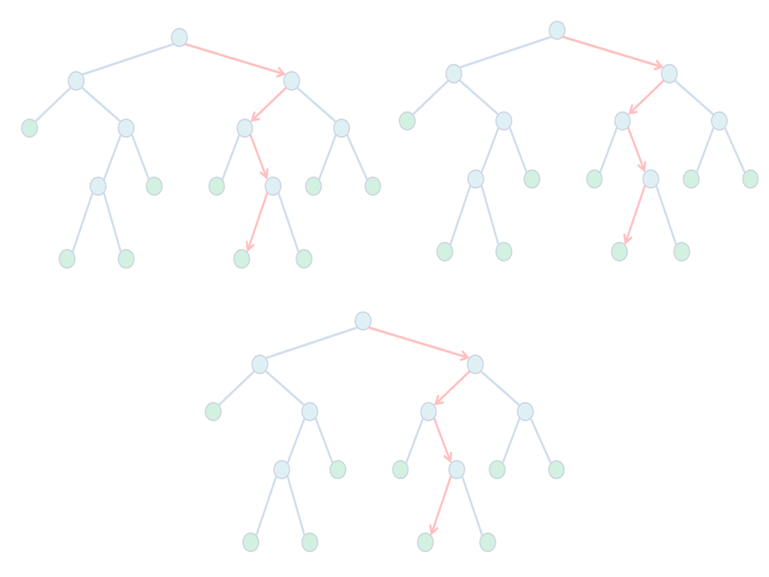
L10: Trees and networks Data clustering
GBIO0009-1
Kirill Bessonov
Nov 24, 2015

Slide 2
Talk Plan
Trees
Basic concepts
Tree-based algorithms
Regression trees
Random Forest
Conditional inference trees
CIFs for network inference
Biological data clustering
Basic concepts

Slide 3
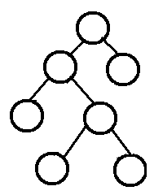
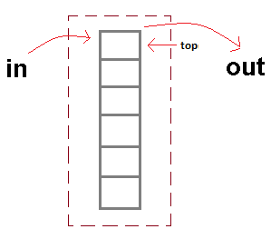
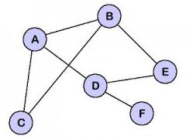
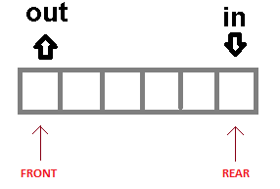
Data Structures
arrangement of data in a computer's memory
Convenient access by algorithms
Main types
Arrays
Lists
Stack
Queue
Binary Trees
Graph
stack
tree
queue
graph

Slide 4
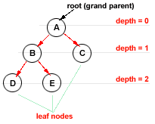
Trees
is a data structure with
a hierarchy relationships
Basic elements
Nodes (N)
Variables
Features
e.g. files, genes, cities
Edges (E)
directed links from
From lower to higher depth

Slide 5
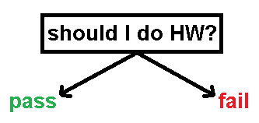
Nodes (N)
Usually defined by one variable
Are selected from {x1 …. xp} variables
Differential selection criteria
E.g. strength of association to response (Y~X)
E.g. “best” split
Others
Node variable could take many forms
question
feature
data point

Slide 6
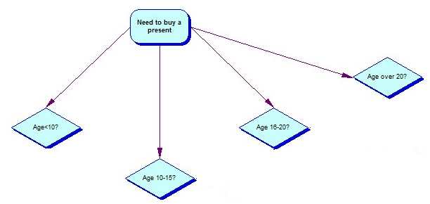
Edges (E)
Edges connects
Parent and child nodes (parent → child)
Directional
Do not have weight
Represent node splits
parent
children

Slide 7
Tree types
Decision
To move to next node need to take decision
Classification
Allow to predict class
use input to predict output → class label
i.e. classify input
Regression
Allow to predict output value
i.e. use input to predict output

Slide 8
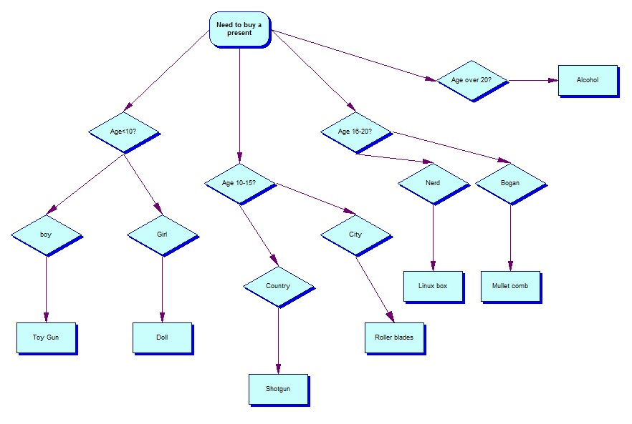
Decision Tree example

Slide 9
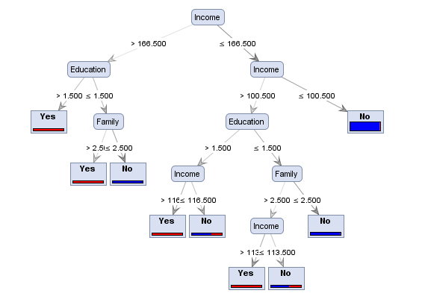
Classification tree
A banking customer would accept a personal loan? Classes = {yes, no}
Leaf nodes predict class of input (i.e. customer)
Output class label – yes or no answer

Slide 10
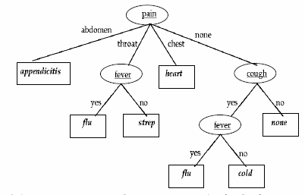
Classification example
Name | Cough | Fever | Weight | Pain | Class
Marie | yes | yes | skinny | none
Jean | no | no | normal | none
Marc | yes | no | normal | none

Slide 11
Classification example
Name | Cough | Fever | Weight | Pain | Class
Marie | yes | yes | skinny | none | flu
Jean | no | no | normal | none | none
Marc | yes | no | normal | none | cold

Slide 12
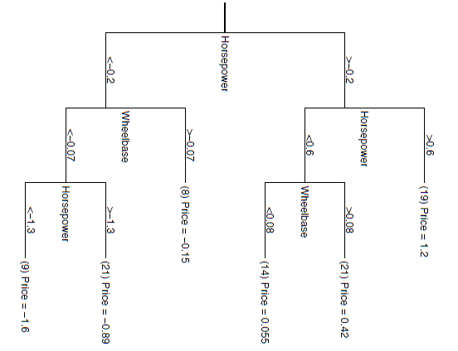
Regression trees
Predict outcome – e.g. price of a car

Slide 13
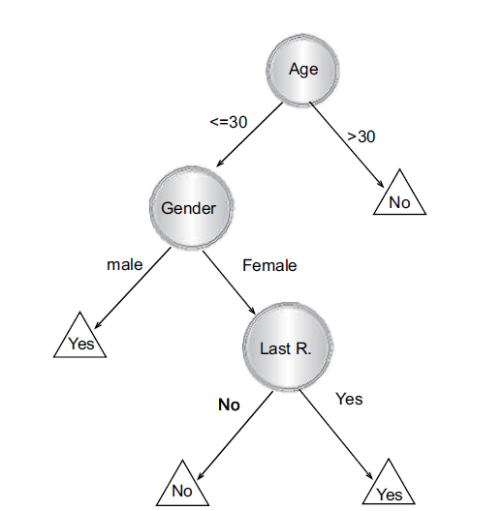
Decision Trees (DTs)
A data structure type
Represents a data model
Purpose 1: recursively partition data
cut data space into perpendicular hyper-planes (w)
Purpose 2: classify data
DTs with class label at the leaf node
E.g. a decision tree that estimates whether or not a potential customer will respond to a direct mailing
predicted binary class: YES or NO
Source: DECISION TREES by Lior Rokach

Slide 14
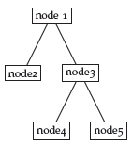
Tree growth and splitting
Selected feature(s)
In top-down approach
assign all data to root node
Select attribute(s)/feature(s) to split the node
Splitting based on
1 feature: univariate split
≥2 features: multivaraite split
Stop tree growth based on
Max depth reached
→Some splitting criteria is not met
X>x
X<x
Y>y
Y<y
Leafs/Terminal
nodes

Slide 15
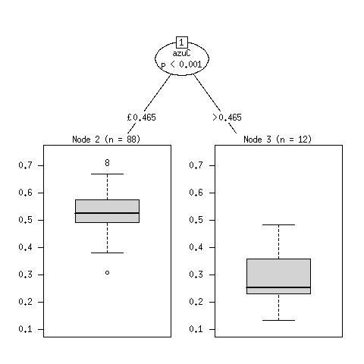
Regression trees
Predict the response (Y)
Break global into local models
A tree is a regression model
Nodes
partitions of data
variables and Y predictions (ŷ)
Leafs
final prediction of Y for
n observations

Slide 16
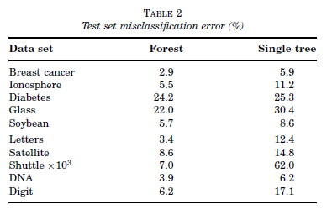
Single against ensemble of trees
Single tree
Easy to interpret and digest
Good visualization
Lower than tree-ensemble performance
Tree ensembles → better performance
* Lower is better
Source: Breiman, Leo. "Statistical modeling: The two cultures." Quality control and applied statistics 48.1 (2003): 81-82.

Slide 17
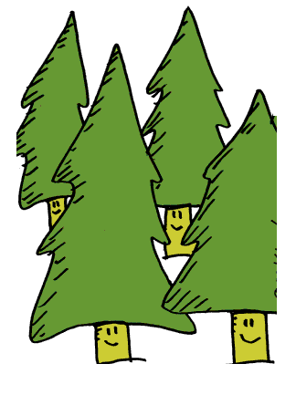
Tree ensembles

Slide 18
Building a forest
Forest
Collection of several trees
Random Forest
Aggregation of several decision trees
Logic
Single tree – too variable performance
Forest of trees – good and stable performance
Predictions averaged over several trees

Slide 19
Random Forests
Randomly build ensemble of trees
Bootstrap a sample of data, start building a tree
Create a node by
Randomly selecting m variables from M
Keep m constant (except for term. nodes)
Split the node based on m variables
Grow a tree until no more splits possible
Repeat steps 1-4 n times
→ Generate an ensemble of trees
Calculate variable importance for each predictor variable X

Slide 20
Random Forest animation
1
{A,B,C,D}
A1 | B1 | C1 | D1
A2 | B2 | C2 | D2
A3 | B3 | C3 | D3
A4 | B4 | C4 | D4
A5 | B5 | C5 | D5
A6 | B6 | C6 | D6
A7 | B7 | C7 | D7
A1 | B1 | C1 | D1
A2 | B2 | C2 | D2
A3 | B3 | C3 | D3
A4 | B4 | C4 | D4
A5 | B5 | C5 | D5
A6 | B6 | C6 | D6
A7 | B7 | C7 | D7
C
A1 | B1 | C1 | D1
A2 | B2 | C2 | D2
A3 | B3 | C3 | D3
A4 | B4 | C4 | D4
A5 | B5 | C5 | D5
A6 | B6 | C6 | D6
A7 | B7 | C7 | D7
<X
>X
2
{A,B,D,D}
3
{A,B,C,D}
D
A
1
<X
C
>X
2
B
3
A
1
1
<X
C
>X
<X
C
>X
2
B
3
B
2
C
3
B

Slide 21
Splits
Based on split purity criteria of a node
gini impurity criterion (GINI index)
measures impurity of the outputs after a split
a split of a node is made on variable m
with lowest Gini Index split (slide 33)
where j is class and p_{j} is probability of class (proportion of samples with class j)

Slide 22
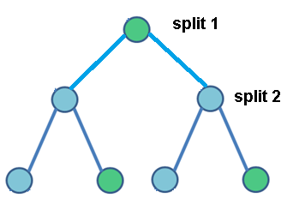
Goodness of split
Which two splits would give
the highest purity ?
The lowest Gini Index ?

Slide 23
GINI Index calculation
At given tree node the probability of p(normal)=0.4 and p(asthma)=0.6. Calculate node GINI Index.
Gini Index = 1 – (0.4² + 0.6²) = 0.48
What will be GINI index of a “pure” node
Gini Index = 0

Slide 24
GINI Index of a split
In case of tree building
GINI Index of a split is used instead
Given node N and a splitting value j*
the left child (N_{left}) has S_{left} samples
The right child(N_{right}) has S_{right} samples
$${Gini index}_{split}\left(N\right)=\frac{S_{left}}{S}gini\left(N_{left}\right)+\frac{S_{right}}{S}gini\left(N_{right}\right)$$

Slide 25
GINI Index split
Given tax evasion data sorted by income variable, choose the best split value based on GINI Index split?
Income | 10K |  | 20K |  | 30K |  | 40K |  | 50K |  | 60K |  | 70K |  | 80K |  | 90K |  | 100K |  | 110K
Split | <= | > | <= | > | <= | > | <= | > | <= | > | <= | > | <= | > | <= | > | <= | > | <= | > | <= | >
Yes | 0 | 3 | 0 | 3 | 0 | 3 | 0 | 3 | 1 | 2 | 2 | 1 | 3 | 0 | 3 | 0 | 3 | 0 | 3 | 0 | 3 | 0
No | 0 | 7 | 1 | 6 | 2 | 5 | 3 | 4 | 3 | 4 | 3 | 4 | 3 | 4 | 4 | 3 | 5 | 2 | 6 | 1 | 7 | 0
GINI Index split | 0.42 |  | 0.4 |  | 0.375 |  | 0.343 |  | 0.417 |  | 0.4 |  | 0.3 |  | 0.343 |  | 0.375 |  | 0.4 |  | 0.42
$${Gini index}_{split}=\frac{6}{10}(1−{\left(3/6\right)}^{2}−{\left(3/6\right)}^{2})+\frac{4}{10}(1−{\left(0/4\right)}^{2}−{\left(4/4\right)}^{2})$$
$${Gini index}_{split}=0.6∗0.5+0.4∗0$$
$${Gini index}_{split}=0.3$$

Slide 26
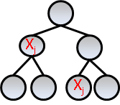
Out-of-the-bag (OOB) samples
OOB
bootstrap
Dataset divided into
Bootstrap (i.e. training)
OOB (i.e. testing)
Trees are built on bootstrap
Predictions are made on OOB
Benefits
avoids over-fitting
false results
OOB
bootstrap
X1…1.5
X2…1.2
X3…-0.5
VIM

Slide 27
RF variable importance (1)
Calculate the misclassification rate = out of bag error rate (OOBerror_{obs}) for each tree
For each variable in the tree, permute values
Using the existing tree
compute the permutation-based
out-of-bag error (OOBerror_{perm})
Aggregate OOBerror_{perm} over all trees
Compute the final VIM

Slide 28
RF variable importance (3)
The VIM mathematically is defined as
$$VIM\left(x_{1}\right)=\frac{1}{ntree}∗ \sum_{t=1}^{ntree}{({OOBerror}_{perm}−{OOBerror}_{obs})}$$
VIM domain {$−∞; +∞$}
Thus, VIM could be negative
Means that variable is insignificative
Ideal situation when ${OOBerror}_{perm}$ > ${OOBerror}_{obs}$

Slide 29
Conditional inference forest (CIF)

Slide 30
Conditional Inference Trees
Author: Torsten Hothorn et.al. (2007)
Recursive partitioning algorithm
Extends Classification And Regression Trees(CART)
Searches for strongest association between
Y response and X covariate(s) : Y ~ X
Y~X association is tested with hypothesis tests
Separate variable selection and best split steps
Tree growth stopping criteria
Null hypothesis of independence can not be rejected
D(Y) = D(Y|X)

Slide 31
CIF algorithm
OOB
bootstrap
Build tree(s) based on boot-strap sample (~0.62% of samples)
For node_{i}
Selection of Xj
Cmax or Cquad on Y~X
Splitting of Xj
Cmax on Y
Given T trees use OOB samples to find VI for X_{1..n}
Normal permutations of X
Conditional permutation of X
Y~X association measure
OOB
bootstrap
X1…1.5
X2…1.2
X3…-0.5
VI

Slide 32
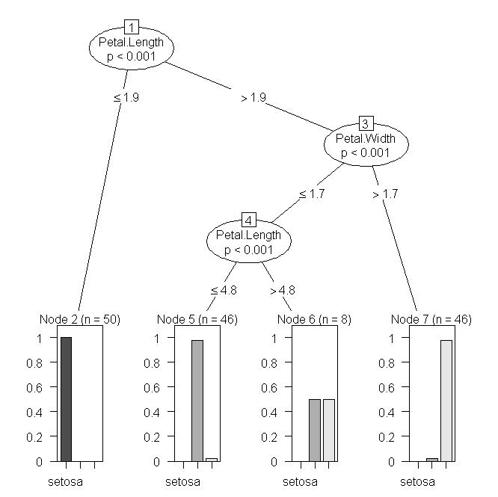
Advantages of CI framework
Variable selection and Node splitting are two separate steps
→ better control/modularity
→ transparency
Statistically sound approach based on
c_{max} or c_{quad} statistic is similar to r
based on global null H₀ tests
avoids variable selection bias towards
continuous variables
variables with large number of splits
provides ways to deal with highly correlated variables
→ varimp(…, conditional = TRUE)
Root node
Node #
p-value
split value
feature
Terminal nodes
Conditional Inference tree
(CI tree)
Notes:
Node #

Slide 33
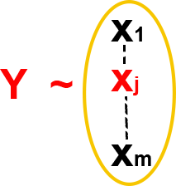
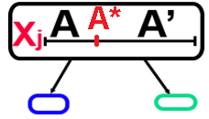
Building Conditional Inference Trees
For each variable X_{j} test “global” null hypothesis H₀ assuming independence between Y (response) and X_{1..m} (covariables) where m is the total # of covariates
Select one covariate X_{j} with strongest association to Y (the largest test-statistic c_{selection})
Select the best split (A*) point out of n_{A} splits for the selected X_{j} at node A by maximizing c_{split}
Stop tree growth when
H₀ can not be rejected (mincriteria < c_{split})
can not split given node anymore (c_{selection} > 0)
Repeat steps 1-4 on ¾ of randomly sampled data
→ Will generate ensemble of trees on in-bag sample → forest
Variable selection
Node splitting

Slide 34
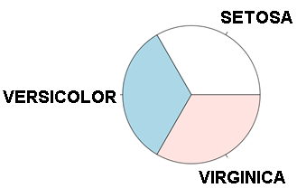
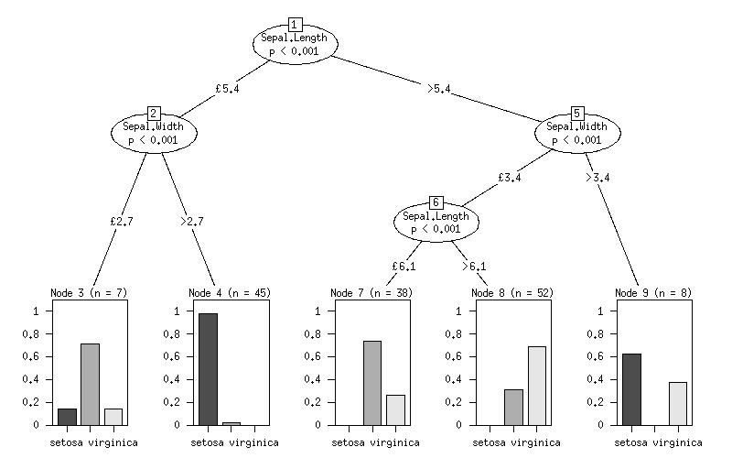
CI tree – categorical response (Y)
Iris dataset
→Y: 3 categories of iris
→X: physical characteristics
50
50
50
Iris categories
Terminal nodes
histograms
iris_ctree <- ctree(Species ~ Sepal.Length+Sepal.Width, data=iris)
Notes:
Terminal nodes

Slide 35
CI tree – continuous response (Y)
Terminal nodes
boxplots
Y → gene expression of a target gene
X → other genes (predictors of Y)

Slide 36
RandomForest vs Conditional Inference
RF: Random Forest based [2] | CI: Conditional Inference forest based [4]
Features are selected based on Classification Node impurity criterion GINI index Continuous response Reduction in residual sum of squares total reduction of variance in response (Y) due to node split | Features are selected based on Node statistical significance (p-value) “multiple-testing “ adjusted p-values Bonferroni Monte-Carlo Classical global H_{o} hypothesis tests
Features importance measure Gini Index biased towards variables with many potential splits Not intuitive apriori significance threshold selection | Features importance measure Based on appropriate association test stat Hypothesis test driven Works across different variable scales More intuitive significance threshold selection (e.g. α = 0.05)

Slide 37
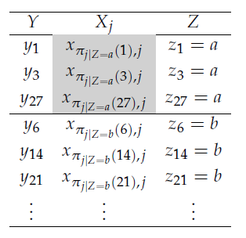
CIF conditional permutation
create conditional list of predictor variables Z associated to selected predictor variable X_{j}
Each z variable is selected by creation of a new tri-node tree created via ctree(). Uses the p-values from the root node, not from the terminal ones. Selects only variables that are bigger than the threshold
data is permuted only in a block defined by: a) data ranges of Z; b)OOB data
Finally permuted indices of observations are being output and used to fit an ensemble of trees
Determine "permuted" error: oobe
Determine “mean decrease in accuracy” (OOBE_{obs.} - OOBE_{perm})
permutation data block
selected predictor
conditional
predictors of Xj
OOB (testing) data
oobe – out of the bag error (error det. from OOB data)
Notes:
Oobe – out of the bag error (error det. from testing data)

Slide 38
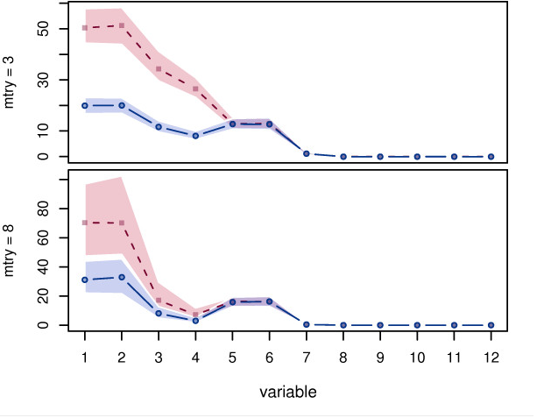
CIFs conditional permutation vs classical one
importance
*- less is better (less bias)
VIM (permutation-based importance):
marginal (dashed red) – classical and
conditional (solid blue) permutation schemes
correlated variables are X₁,..., X₄
source: Strobl, Carolin, et al. "Conditional variable importance for random forests." BMC bioinformatics 9.1 (2008): 307.

Slide 39
CIF to interaction networks (1)
Can we build networks from tree ensembles?
Need to consider all possible interactions
Y₁~X, then Y₂~X … Y_{p}~X
Need to “shift” Y to new variable
Assign Y to new variable (previously X)
Complete matrix of interactions (i.e. network)

Slide 40
CIF to interaction networks (2)
Given gene expression data
consider iteratively each gene expression as output (response)
use remaining genes as input (predictors).
Construct a conditional inference tree (CIT) or conditional inference forest (CIF) per input/output.
Use all trees in ensemble
- derrive variable importance measure (VIM).
Construct a non-symmetric adjacency matrix and hence a directed network.

Slide 41
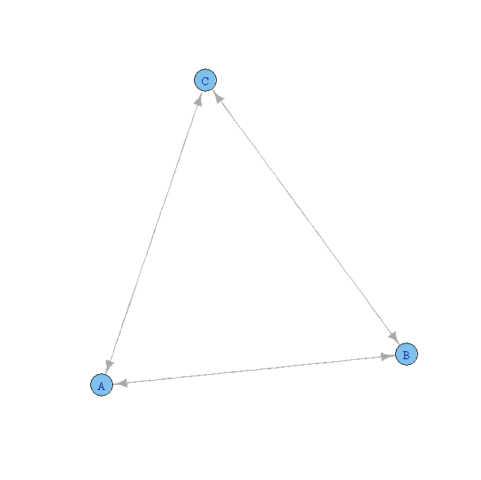
CIF to interaction networks (3)
Each run
completes one row of adjacency matrix
Given 10 genes
10 conditional inference forests
i.e. 10 runs
VIM is the node edge weight

Slide 42
Conditional inference trees
party() package in R
by Torsten Hothorn

Slide 43
Building a CI tree
To build , tune and plot CI tree one uses
ctree_control()
specifies parameters for CI tree building
ctree()
builds the CI tree according to parameters
plot()
Calls internal plot.BinaryTree() function

Slide 44
ctree_control()
ctree_control(teststat = c("quad", "max"),
testtype=c("Bonferroni","MonteCarlo","Univariate","Teststatistic"),
mincriterion = 0.95, minsplit = 20, minbucket = 7,
stump = FALSE, nresample = 9999, maxsurrogate = 0,
mtry = 0, savesplitstats = TRUE, maxdepth = 0)
teststat → type of c test-statistic of “maximum” or “quadratic” form
testtype → type of p-value to compute and mulitple-testing adjustments
Univariate → raw p-value (no adjustments) assuming normal distribution of test statistic
Teststatistic → only raw test statistic is being calculated (no p-values)
mincriterion could be >1 and refers to teststat (p-value=teststat)
Bonferroni → adjust raw p-value using multiple testing correction: 1-(1-p)^{m}
MonteCarlo → adjust raw p-values (# of times c_{monte-carlo} > c_{obs} /# re-samples)
micriterion → min p-value (left area) to meet in order to split the node
mtry → n number of X variables out of X_{1…m} to select at every node (0=all)
minsplit → minimum number of observations present in each node
maxdept → maximum number of levels in the tree
savesplitstats → if c_{split} stats need to be saved in the final object

Slide 45
ctree()
ctree(formula, data, subset = NULL, weights = NULL,
controls = ctree_control(),
xtrafo = ptrafo, ytrafo = ptrafo, scores = NULL)
formula → describe relationship between Y~X
data → data frame containing all Y and X variables
weights → user defined weights related to observations
controls → object of type “TreeControl” from ctree_control()
xtrafo → function to transform data in X
ytrafo → function to transform data in Y

Slide 46
Building a CI forests (CIF)
To build , tune and get results from CIF one uses
cforest_control()
specifies parameters for CI tree building
cforest()
builds the CI tree according to parameters
varimp()
Calculate variable importance using ensemble of CI trees
plot()is not available
can plot individual trees

Slide 47
cforest_control()
Build ensemble of trees and output a RandomForest object
cforest_control(teststat = "max",
testtype = "Teststatistic",
mincriterion = qnorm(0.9),
savesplitstats = FALSE,
ntree = 500, mtry = 5,
replace = TRUE, fraction = 0.632, trace = FALSE, ...)
testtype → select one of 4 possible ways to calculate test statistic
mincriterion → controls splitting process / tree growth
ntree → number of trees to generate
mtry → number of variables randomly select at each node
replace → for each tree sample two ways to sample observations
with replacement, some of observations can be selected more than once
without replacement randomly resample (no reselection of obs)
fraction → % of the observations that will be used to construct a tree
trace → show or not the progress bar

Slide 48
cforest_classical()
cforest_classical(teststat = "max",
testtype = "Teststatistic",
mincriterion = qnorm(0.9),
savesplitstats = FALSE,
ntree = 500, mtry = 5,
replace = TRUE, fraction = 0.632, trace = FALSE, ...)
teststatistic → C_{max}
testtype → Teststitisic
Only the test statistic will be calculated (not p-value)
mincriterion → qnorm(0.9) ~ 1.28
teststatitic threshold for splits to exceed
Sample with replacement (bootstrapping)
The weights are drawn from n observations using the multinomial distribution
Some observations could be selected more than once (with weights > 1)

Slide 49
cforest_unbiased()
cforest_unbiased(teststat = "quad",
testtype = "Univariate",
mincriterion = 0,
savesplitstats = FALSE,
ntree = 500, mtry = 5,
replace = FALSE, fraction = 0.632, trace = FALSE, ...)
teststatistic → C_{quad}
testtype → Univariate
Raw p-values will be calculated without any multiple-testing correction
mincriterion → 0
p-value based threshold. Since mincriterion=0, no threshold is being applied
Sample without replacement (re-sampling)
The weights are randomly drawn from n observations
All observations with weight w {0,1} (max weight is 1 for any obs.)

Slide 50
cforest()
cforest(formula, data = list(), subset = NULL,
weights = NULL,
controls = cforest_unbiased(),
xtrafo = ptrafo, ytrafo = ptrafo, scores = NULL)
formula → describe relationship between Y~X
weights → user defined weights related to observations
controls → object with parameters controlling cforest()
The ForestControl object is specified by cforest_unbiased()
Improved unbiased version of classical RandomForest algorithm
The ForestControl object is specified by cforest_classical()
Similar to classical RandomForest algorithm

Slide 51
varimp()
Compute standard and conditional variable importance (‘mean decrease in accuracy’) for CIF
varimp(object, mincriterion = 0,
conditional = FALSE, threshold = 0.2, nperm = 1,
OOB = TRUE, pre1.0_0 = conditional)
object → “RandomForest “object from cforest()
mincriterion → threshold of the node split statistic to exceed
conditional → if variable importance should be conditioned on other covariates (Z) in addition to X_{j}
threshold → the p-value threshold for selection of covariates Z conditioned on X_{j}
nperm – number of permutations (# of times to select a new OOB)

Slide 52
Glaucoma example

Slide 53
CITs in action
Build tree from glaucoma data
Assess it classification performance
install.packages("party", repos="http://cran.freestatistics.org")
library(party)
data("GlaucomaM", package = "TH.data")
GlaucomaM[1:3,]
ag at as an ai class
2 2.220 0.354 0.580 0.686 0.601 … normal
43 2.681 0.475 0.672 0.868 0.667 … normal
25 1.979 0.343 0.508 0.624 0.504 … normal

Slide 54
Prediction of a class
gtree <- ctree(Class ~ ., data = GlaucomaM)
plot(gtree)
acc =table(Predict(gtree), GlaucomaM$Class)
glaucoma normal
glaucoma 74 5
normal 24 93
acc = sum( diag(cmatrix) )/sum(cmatrix)
print(acc)
Accuracy of a single tree: 0.852

Slide 55
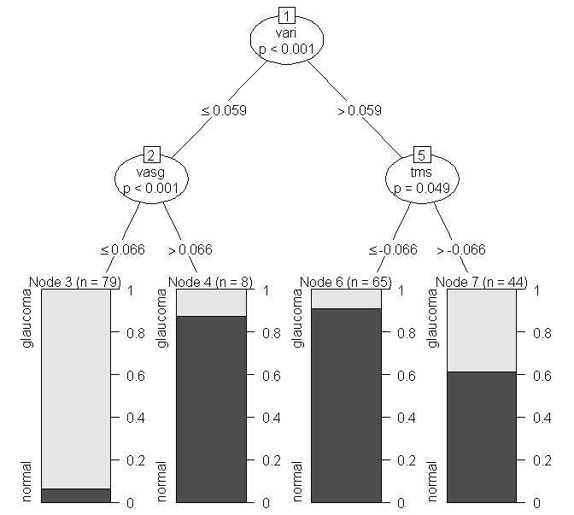
Single CI tree

Slide 56
Data Clustering

Slide 57
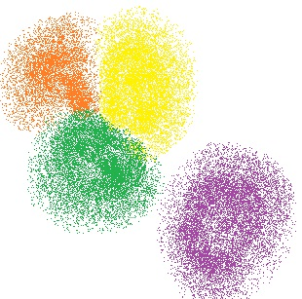
Clustering – “grouping” of data
e.g. cluster #2
Clustering refers to the process of data division into groups
Hopefully groups are informative
Natural concept to humans
e.g. cluster #1
Source: http://www.aishack.in/wp-content/uploads/2010/07/kmeans-example.jpg
Cluster is a group of objects or data points
“similar” between themselves and
“dis-similar” to other objects assigned to other clusters

Slide 58
Usefulness of data clustering
Uses of clustering
To discover new categories in data
To find hidden “structure” in data
Simplify data analysis by
working on subset of data
working with clusters instead of individual observations
Can be applied to many contexts (same techniques):
Marketing: grouping of customers with similar behavior
Biology: classification of patients based on clinical history
Libraries: order books based into categories(e.g. science fiction, detective, etc.)

Slide 59
Ideal clustering
Be able to deal with different types of data
E.g. continuous, categorical, rank-based
Being able to discover clusters of irregular shape (not only circular)
Being able to deal with high-dimensionality
Minimal input parameters (if any)
Interpretability and usability
Reasonably fast (computationally efficient)

Slide 60
Main types of clustering
Exclusive
One data point should belong only to 1 cluster
Overlapping
Given data point can belong to more than 1 cluster
Hierarchical
Progressively merge small clusters into bigger ones while building a hierarchical tree
Probabilistic
Uses probabilistic model to determine on how given data point was generated

Slide 61
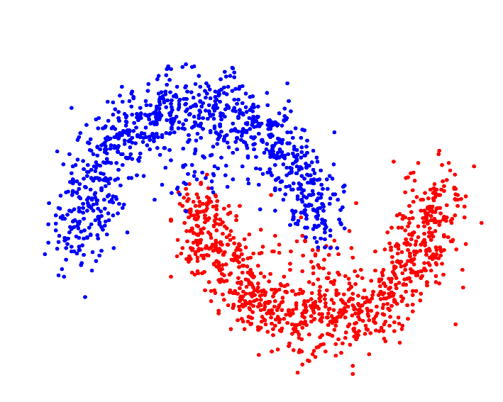
Exclusive clustering
One data point can only belong to only ONE cluster
Algorithms:
K-means, SVNs,
EM (expectation maximization)
No overlapping is observed between clusters
K-means is the most popular

Slide 62
Similarity measures (1)
How one decides non-visually if given data
point belongs to given cluster?
Similarity measure s(x_{i},x_{k})
assesses similarity between obeservations
large if x_{i},x_{k} are similar
Dis-similarity measure d(x_{i},x_{k}) – i.e. distance
assesses dis-similarity
Large if x_{i},x_{k} are dis-similar
Could be thought as a distance between data points

Slide 63
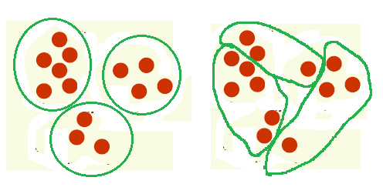
Similarity measures (2)
Distance measures:
Euclidean distance (in 2D similar to distance)
Manhattan (city block) distance
Good clustering Bad clustering

Slide 64
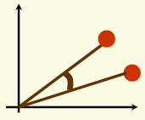
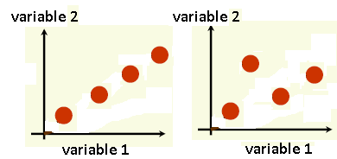
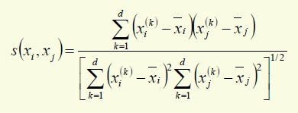
Similarity measures (3)
Cosine similarity
Smaller the angle, the greater is similarity
Used in text mining
Correlation coefficient
Similar to cosine similarity
Not susceptible to scale/absolute values
Looks at shape

Slide 65
Misclassification errors
In classification context:
our aim is to assign new unknown samples to known classes (e.g. clusters labeled with class)
Misclassification happens when
sample X belonging to clusters A is wrongly assigned to cluster B
In this case clustering algorithm produces
wrong class assignment to the sample X
could be estimated using %accuracy, %precision, ROC curves, other performance measures

Slide 66
Misclassification measures
TP = true positive predicted result that matches the golden standard
TN= true negative predicted result that matched the golden standard
FN = the false negative predicted result that is actually positive according to gold standard
FP= the false positive predicted result that is actually negative according to gold standard
Accuracy
Precision
Recall/True Positive Rate (TPR)
False Discovery Rate (FDR)

Slide 67
Unsupervised clustering features
Data has no labels or classified yet
does not take into account
information about sample classes or labels
Parametric approach
Estimate parameters about data distribution
Hard to implement for complex datasets
Non-parametric
Minimum input parameters required
No information about data is needed
Data grouped into clusters

Slide 68
Unsupervised clustering questions
Are there clusters present in the data?
Does the obtained clusters
are in agreement with the prior knowledge?
Do the identiﬁed clusters ﬁt the data well
based on specific parameter
e.g. error function is minimized)?
If true sample labels are known (but not used during clustering)
how well the obtained clusters classify samples?
external a posteriori validation

Slide 69
Supervised clustering
Sample labels used in clustering
Used to
look for outliers in a given class
Identify mislabeled samples
Maximize class purity
Algorithms
Supervised Partitioning Around Medoids (SPAM)
Supervised Clustering using Evolutionary Computing (SCEC)

Slide 70
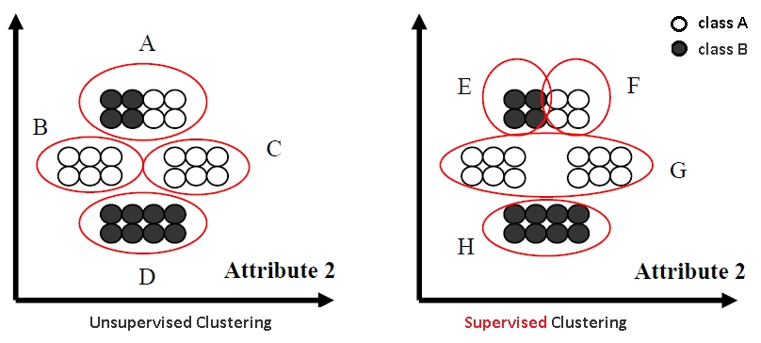
Unsupervised VS Supervised
Unsupervised clustering created impure cluster A
Supervised clustering made cluster A pure (classes are known and used during clustering)

Slide 71
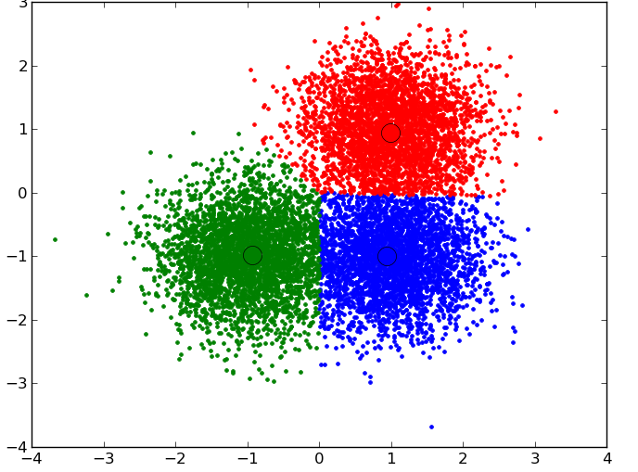
K-means
Simplest unsupervised clustering algorithm
Requires specification of expected number of clusters (i.e. k = # of clusters)
Similarity is calculated based on Euclidian distance
k=3

Slide 72
K-means algorithm
Given dataset X={x₁,….x_{n}} assign to clusters c={c₁,…,c_{k}}
Place centroids u={u₁,..,u_{k}} as far apart as possible. If not a 1st iteration, recalculate centroids of the clusters c
Take points in the dataset and associate them to centroids u populating clusters c
Repeat steps 1-3 until no centroids do not move and acceptable error function threshold is met

Slide 73
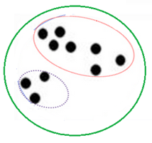
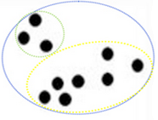
Hierarchical clustering
Divides or aggregates data recursively into groups
Agglomerative
Bottom-up approach. Start from small clusters and start aggregation process to create larger clusters
Divisive
From one cluster representing whole data start dividing it into small parts
Data separation process is based on nested clusters
Smaller clusters within other bigger clusters
Two nested clusters green and blue with 2 smaller clusters each

Slide 74
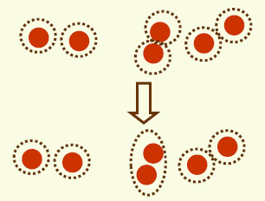
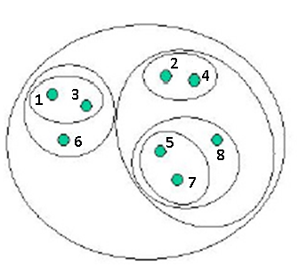
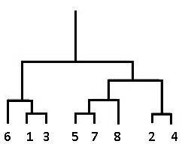
Hierarchical clustering
Agglomerative:
Start by assigning each data point to a cluster c_{i{1..n}} so that you have n clusters each containing just one item
Find the pair of clusters c_{i} and c_{j} (having the smallest distance/largest similarity between them) and merge them into a single cluster c_{k}=c_{i}∪c_{j}
Eliminate selected clusters c_{i} and c_{j} from the list of clusters c
Compute and update distances (similarities) between the new cluster and each of the old clusters
Repeat steps 2-4 until the total number of clusters n=1 (one big cluster)
Hierarchical tree

Slide 75
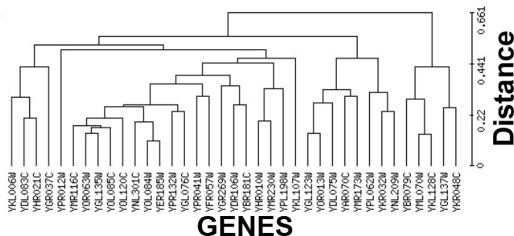
Hierarchical tree
Tree levels
cut tree horizontally
top levels → larger clusters
bottom levels → smaller clusters
the very bottom level of the tree
contains clusters with class label assigned
smallest clusters
Branches of the tree represent distances between clusters
Source: Daqing Mao, Yi Luo, Jinghai Zhang and Jun Zhu A NEW STRATEGY OF COOPERATIVITY OF BICLUSTERING AND HIERARCHICAL CLUSTERING: A CASE OF ANALYZING YEAST GENOMIC MICROARRAY DATASETS
Notes:
Source:

Slide 76
Hierarchical clustering - distance
Cluster distance measured
Minimal distance (single linkage, nearest neighbor)
Encourages growth of elongated clusters
Sensitive to noise
Maximum distance (complete linkage)
Encourages compact clusters
Does not work well on elongated clusters
Average distance
Mean distance
Cheaper to compute than average distance
More robust to noise, more stable

Slide 77
Principal component analysis (PCA)
Non-parametric method of extracting patterns in data from complex/high-dimentional datasets
Used for data compression and simplification
Extraction of “relevant” data
Reduction of data dimentionality
Comes from linear algebra
Relies on variance present in data
Not a clustering technique, but used together with clustering such as k-means

Slide 78
Principal component analysis (PCA)
Assumes “linearity” in data
Hidden factors in data have an additive nature
Usually a good approximation to take
Designed to analyze variance in data via
Covariance matrix
Correlation matrix
Data could be transformed to lower dimensions via eigenvectors (principal components) capturing the largest variance in input data

Slide 79
PCA algorithm in nutshell
Relies on manipulation of matrices via linear algebra
Subtract mean from each variable vector (e.g. gene or individual, etc.) → centers data
Calculate co-variance matrix
Calculate the eigenvectors and eigenvalues of the covariance matrix
Choose principal components (PCs)
the eigenvector with the highest eigenvalue is the principle component of the data set
eigenvectors are perpendicular to each other
Transpose data along selected principal components

Slide 80
PCA illustration example (1)
1) Subtract means Xbar and Ybar from the data
x | y
2.5 | 2.4
0.5 | 0.7
2.2 | 2.9
1.9 | 2.2
3.1 | 3
2.3 | 2.7
2 | 1.6
1 | 1.1
1.5 | 1.6
1.1 | 0.9
x | y
0.69 | 0.49
-1.31 | -1.21
0.39 | 0.99
0.09 | 0.29
1.29 | 1.09
0.49 | 0.79
0.19 | -0.31
-0.81 | -0.81
-0.31 | -0.31
-0.71 | -1.01

Slide 81
PCA illustration example (2)
2) Calculate co-variance of X and Y vectors: cov()
3) Calculate eigenvalue and eigenvector from the covariance matrix: eigen(covariance matrix)
4) Choose eigenvectors (PCs) with highest eigenvalues
In these case the 1st eigenvector could be selected (PC1)
 | x | y
x | 0.616556 | 0.615444
y | 0.615444 | 0.716556
 | x | y
x | 0.677873 | -0.73518
y | 0.735179 | 0.677873
eigenvalues | 1.28 | 0.049
PC1 PC2

Slide 82
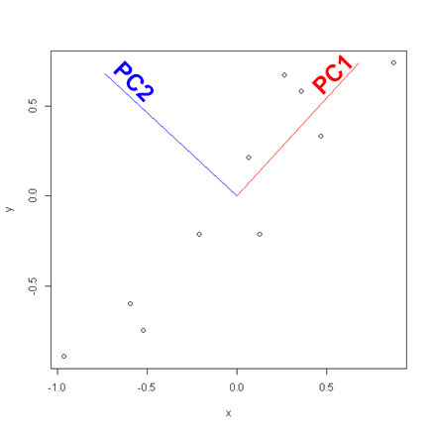
PCA illustration example (3)
5) Transpose data along selected PCs
As expected PC1 captures most data variance
To transpose multiply selected eigenvectors by initial data
Transposed data = eigenvectors x mean-subtracted data

Slide 83
R implementation of PCA
R contains several functions to perform pca
princomp(): stats library
prcomp(): stats library
PCA (): FactoMineR library

Slide 84
prcomp() function
> pca = prcomp(data, retx=T)
> pca
Standard deviations:
[1] 1.1331495 0.2215477
Rotation:
PC1 PC2
x -0.6778734 0.7351787
y -0.7351787 -0.6778734
Co-variance matrix with PCs along columns

Slide 85
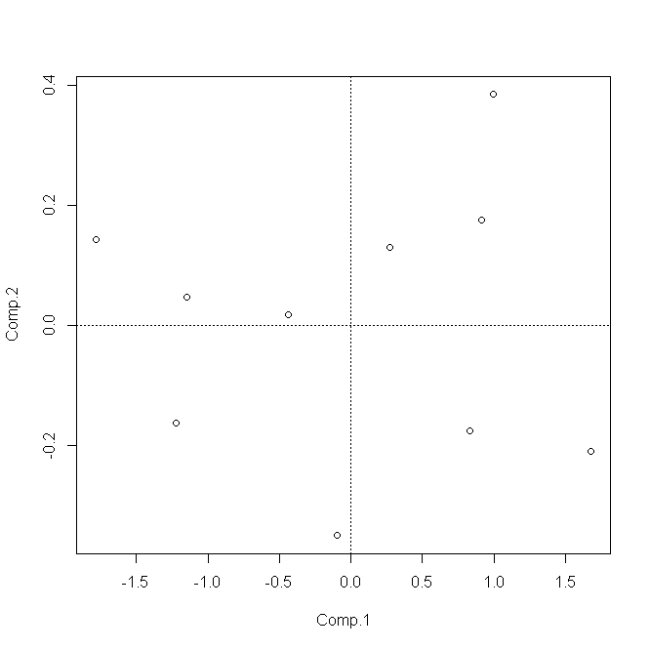
prcomp() function
Data is rotated or superimposed onto the selected 2 PCs acting as news axis
New coordinates for x and y vectors along PC1 and PC2
pca$x
PC1 PC2
[1,] -0.82797019 0.17511531
[2,] 1.77758033 -0.14285723
[3,] -0.99219749 -0.38437499
[4,] -0.27421042 -0.13041721
[5,] -1.67580142 0.20949846
[6,] -0.91294910 -0.17528244
[7,] 0.09910944 0.34982470
[8,] 1.14457216 -0.04641726
[9,] 0.43804614 -0.01776463
[10,] 1.22382056 0.16267529

Slide 86
prcomp() function
Obtaining information on variance explained by each PC
> summary(pca)
Importance of components:
Comp.1 Comp.2
Standard deviation 1.0750000 0.21017864
Proportion of Variance 0.9631813 0.03681869
Cumulative Proportion 0.9631813 1.00000000

Slide 87
princomp() function in R
> pca = princomp(data, retx=T)
> pca
Call:
princomp(x = data, retx = T)
Standard deviations:
Comp.1 Comp.2
1.0750000 0.2101786
2 variables and 10 observations.

Slide 88
princomp() function in R
> attributes(pca)
$names
[1] "sdev" "loadings" "center" "scale" "n.obs" "scores" "call"
$class
[1] "princomp"
> pca$scores
Comp.1 Comp.2
[1,] 0.82797019 -0.17511531
[2,] -1.77758033 0.14285723
[3,] 0.99219749 0.38437499
[4,] 0.27421042 0.13041721
[5,] 1.67580142 -0.20949846
[6,] 0.91294910 0.17528244
[7,] -0.09910944 -0.34982470
[8,] -1.14457216 0.04641726
[9,] -0.43804614 0.01776463
[10,] -1.22382056 -0.16267529
Rotated along PC1 and PC2 values of
mean subtracted vectors X and Y

Slide 89
princomp()
To print information on eigenvectors(PCs)
> pca$loadings
Loadings:
Comp.1 Comp.2
x 0.678 -0.735
y 0.735 0.678

Slide 90
Data Mining field
Data Mining (DM) is a field that uses other techniques to analyze data and to find patterns in data
The techniques used are often do not have solid statistical basis
DM based methods can process huge amounts of data
Classification Rules, Association Rules, Neural Networks, Supporter Vector Machines

Slide 91
Final remarks
Making sense of data is very important task for XXI century
Easy to generate data
Hard to make any sense of collected data
The data clustering and data complexity reduction techniques could be applied in any discipline (Biology, Physics, Economics)
No method is perfect
Active research in fields related to Big Data analysis
Data Mining, Statistics, Machine Learning

Slide 92
References
[1] Leo Breiman Random Forests October 2001, Volume 45, Issue 1, pp 5-32 doi: 10.1196/annals.1407.021
[2] Huynh-Thu, V. A., Irrthum, A., Wehenkel, L., and Geurts, P. Inferring regulatory networks from expression data using tree-based methods. PLoS ONE, 5(9):e12776, 2010
[3] Hothorn, T., Hornik, K., Zeileis, A., 2006. Unbiased recursive partitioning: a conditional inference framework. J. Comput. Graph. Statist. 15, 651–674
[4] Marbach D. Wisdom of crowds for robust gene network inference. Nat Methods. 2012 Jul 15;9(8):796-804
[5] http://home.deib.polimi.it/matteucc/Clustering/tutorial_html/
[6] http://www.hypertextbookshop.com/dataminingbook/public_version/contents/chapters/chapter004/chapter.html
[7] Strobl, Carolin, et al. "Conditional variable importance for random forests." BMC bioinformatics 9.1 (2008): 307.
[8] Breiman, Leo. "Statistical modeling: The two cultures." Quality control and applied statistics 48.1 (2003): 81-82.
[9] Liaw, Andy, and Matthew Wiener. "Classification and regression by randomForest." R news 2.3 (2002): 18-22.

