Slide 1
Bioinformatics Next-generation sequencing vs. Microarray in epigenetic
Bosch Vincent
Klecker Sophie
Straat Julien
© Copyright 2013

Slide 2
Talk Outline
Summary
Microarray
NGS
Discussion
Conclusion
Introduction
Talk Outline
Summary
Microarray
NGS
S./Illumina
SOLiD
454
Comparison
Discussion
Future
SMRT
Conclusion
Bibliography
Q & A
Notes:
Val

Slide 3
Summary
« Advantages of next-generation sequencing versus the microarray in epigenetic research »
Paul J. Hurd and Christopher J. Nelson
25 June 2009
Introduction
Talk Outline
Summary
Microarray
NGS
S./Illumina
SOLiD
454
Comparison
Discussion
Future
SMRT
Conclusion
Bibliography
Q & A
Notes:
Val

Slide 4
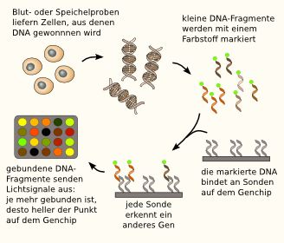
Microarray
http://www.wissensschau.de/genom/gentest_microarray_genchip.php
Introduction
Talk Outline
Summary
Microarray
NGS
S./Illumina
SOLiD
454
Comparison
Discussion
Future
SMRT
Conclusion
Bibliography
Q & A
Notes:
Val

Slide 5
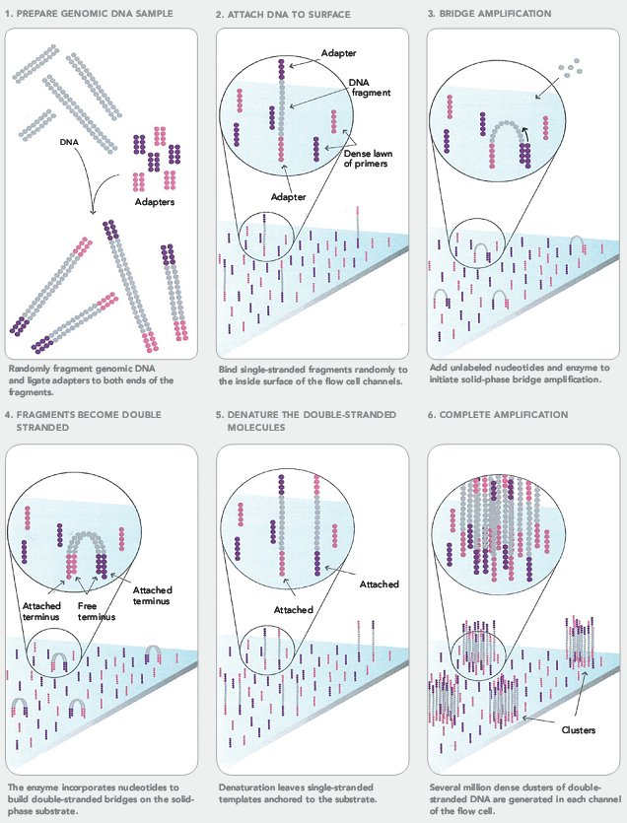
Solexa/
Illumina
Introduction
Talk Outline
Summary
Microarray
NGS
S./Illumina
SOLiD
454
Comparison
Discussion
Future
SMRT
Conclusion
Bibliography
Q & A
http://seqanswers.com/forums/showthread.php?t=21
Notes:
Ced

Slide 6
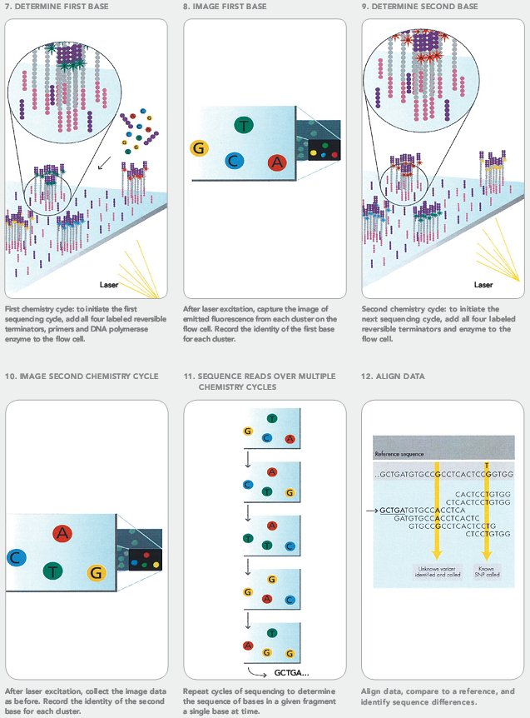
Solexa/
Illumina
Introduction
Talk Outline
Summary
Microarray
NGS
S./Illumina
SOLiD
454
Comparison
Discussion
Future
SMRT
Conclusion
Bibliography
Q & A
Go further:
http://www.dnatube.com/video/27892/What-is-Illumina-Solexa-sequencing-
http://seqanswers.com/forums/showthread.php?t=21
Notes:
Ced

Slide 7
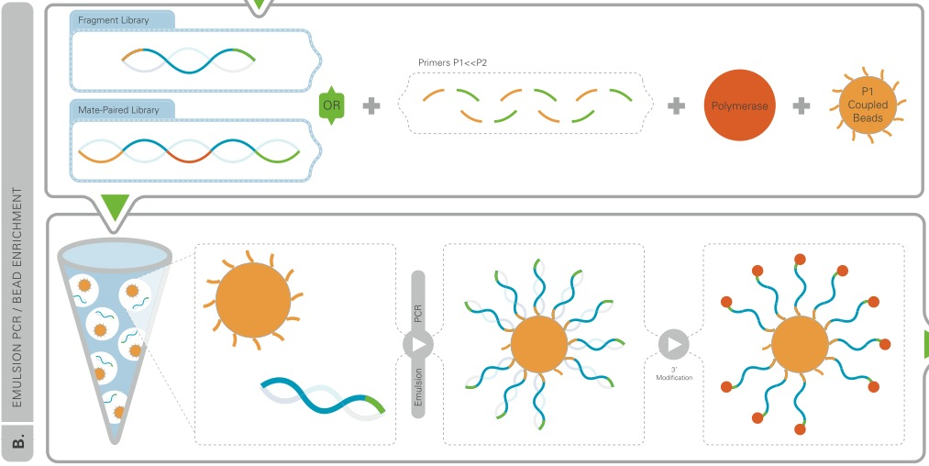
SOLiD
Introduction
Talk Outline
Summary
Microarray
NGS
S./Illumina
SOLiD
454
Comparison
Discussion
Future
SMRT
Conclusion
Bibliography
Q & A
http://pingjie.wordpress.com/2009/03/05/
Notes:
Ced

Slide 8
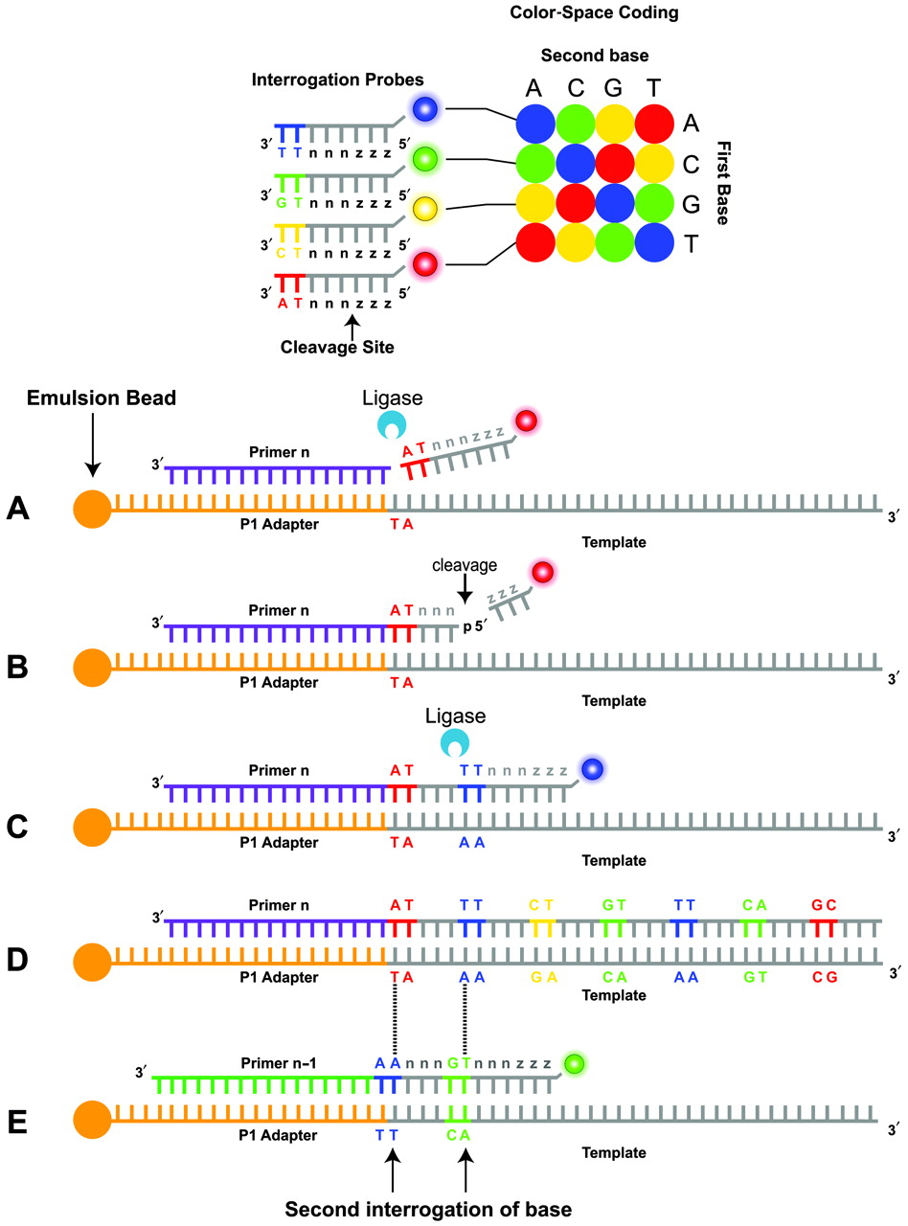
SOLiD
Introduction
Talk Outline
Summary
Microarray
NGS
S./Illumina
SOLiD
454
Comparison
Discussion
Future
SMRT
Conclusion
Bibliography
Q & A
Go further:
http://www.youtube.com/watch?v=nlvyF8bFDwM
http://www.clinchem.org/content/55/4/641/F3.expansion
Notes:
Ced

Slide 9
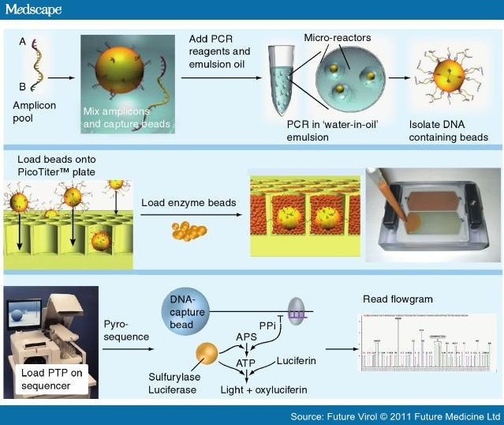
454 Pyrosequencing
Introduction
Talk Outline
Summary
Microarray
NGS
S./Illumina
SOLiD
454
Comparison
Discussion
Future
SMRT
Conclusion
Bibliography
Q & A
http://www.medscape.com/viewarticle/738786_6
Go further: http://www.youtube.com/watch?v=nFfgWGFe0aA
Notes:
Ced

Slide 10
Comparison
Introduction
Talk Outline
Summary
Microarray
NGS
S./Illumina
SOLiD
454
Comparison
Discussion
Future
SMRT
Conclusion
Bibliography
Q & A
Notes:
Ced

Slide 11
Future of Microarrays and NGS
Introduction
Talk Outline
Summary
Microarray
NGS
S./Illumina
SOLiD
454
Comparison
Discussion
Future
SMRT
Conclusion
Bibliography
Q & A
Microarrays :
Used by most of the researchers and available informatic tools
Cheaper (small genome)
Dominate certain application

Slide 12
Future of Microarrays and NGS
Introduction
Talk Outline
Summary
Microarray
NGS
S./Illumina
SOLiD
454
Comparison
Discussion
Future
SMRT
Conclusion
Bibliography
Q & A
NGS technologies:
Read longer sequences
Faster reading
Become more affordable

Slide 13
Future of Microarrays and NGS
Introduction
Talk Outline
Summary
Microarray
NGS
S./Illumina
SOLiD
454
Comparison
Discussion
Future
SMRT
Conclusion
Bibliography
Q & A
Example: Human genome sequencing
2003
~2.7 billon dollars
13 years
2008 (with NGS)
~30 million dollars (1%)
2 months

Slide 14
Future of Microarrays and NGS
Introduction
Talk Outline
Summary
Microarray
NGS
S./Illumina
SOLiD
454
Comparison
Discussion
Future
SMRT
Conclusion
Bibliography
Q & A
NGS technologies & microarrays : work together
Microarrays : survey of a genome
NGS tech.: more accurate data
Examples:
Microarrays, 454 and Solexa/Illumina
Bisulphite-treatment and MeDIP

Slide 15
Single Molecule Real Time sequencing
Introduction
Talk Outline
Summary
Microarray
NGS
S./Illumina
SOLiD
454
Comparison
Discussion
Future
SMRT
Conclusion
Bibliography
Q & A
Single Molecule Real Time sequencing
How does it work?
A single molecule of DNA polymerase
Real-time analyses
Advantages
Extremely high-throughput
Decreasing sequencing time

Slide 16
Conclusion
Introduction
Talk Outline
Summary
Microarray
NGS
S./Illumina
SOLiD
454
Comparison
Discussion
Future
SMRT
Conclusion
Bibliography
Q & A
Microarrays
NGS technologies
New generation:
Third generation: SMRT
Fourth generation: still in development
Data analysis, management, storage?

Slide 17
Bibliography
Introduction
Talk Outline
Summary
Microarray
NGS
S./Illumina
SOLiD
454
Comparison
Discussion
Future
SMRT
Conclusion
Bibliography
Q & A
Advantages of next-generation sequencing versus the microarray in epigenetic research. Paul J. Hurd and Christopher J. Nelson, 25 June 2009
http://seqanswers.com/forums/showthread.php?t=21
http://pingjie.wordpress.com/2009/03/05/
http://www.clinchem.org/content/55/4/641/F3.expansion
http://www.medscape.com/viewarticle/738786_6

Slide 18
Introduction
Talk Outline
Summary
Microarray
NGS
S./Illumina
SOLiD
454
Comparison
Discussion
Future
SMRT
Conclusion
Bibliography
Q & A
Q & A

