Slide 1
HW1b: Background information
Oct 8th, 2013
Kyrylo Bessonov

Slide 2
Talk outline
Introduction to Genome-Wide Association Studies
typical design - statistical models used
Tips and resources
Introduction to HW1b:
HW1b – type 1: Literature review
HW1b – type 2: Computer based
HW1b – type 3: Q&A based
Concluding remarks and questions

Slide 3
GWAS - Genome-wide association study
GWAS tries to find possible association between genotypes (SNPs) and trait (e.g. disease state)
The genotypes (i.e. SNPs) that are statistically strongly associated with the trait could be thought as risk factors that increase chances of the disease onset
Typically the datasets are of very large size containing more than ½ - 1 million markers (SNPs)
Need quick efficient statistical approaches to scan all markers (and sometimes all pairwise combinations!)

Slide 4
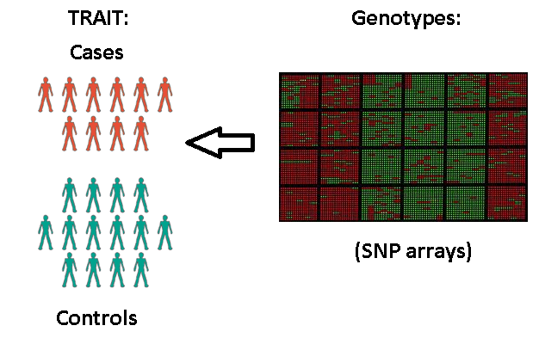
GWAS visually
Example of binary trait (case or control)
Genotypes are represented as SNP names
rs followed by the # (e.g. rs2305089) rs2305089

Slide 5
GenABEL: genome-wide SNP association analysis
The mission of the GenABEL project is to provide a free framework for collaborative, robust, transparent, open-source based development of statistical genomics methodology. (source: http://www.genabel.org/)
GWAS related *ABEL packages:
GenABEL - for quantitative, binary and time-till-event traits
ProbABEL - genome-wide association analysis of imputed data
MixABEL - mixed models for genome-wide association analysis
OmicABEL - mixed-model based GWAS for both single trait and multiple trait ("omics") analyses
Install in R by install.packages("GenABEL")
Extensive tutorial could be consulted here

Slide 6
GenABEL data storage
Typical in GWAS there are 2 types of data:
Phenotypic: information on samples (sex, age, trait)
Genomic: information on genotypes (SNP states)
Data stored in data object:
Access phenotypic data: … @phdata
Access genotypic data: …@gtdata
where “…” represents name of GenABEL object
Data object could be saved as *.raw file

Slide 7
Homework - HW 1B
Total of 3 choices of HW types
Literature bases
Computer / programming based in R
Q&A based – review of GenABEL
Due date: November 8th (Friday) @ midnight

Slide 8
HW1b – type 1: Literature review

Slide 9
HW1b – type 1: Literature review
Consists of literature review
Total of 4 paper choices
Paper 1: “A vision for the future of genomics research”
Paper 2: “Genotyping errors: causes, consequences and solutions”
Paper 3: “Replicating genotype-phenotype associations…” AND “…choice of population structure..”
Paper 4: “Rare and common variants: twenty arguments”
Submission includes written report (due Nov 8th) and oral group presentation (Dec 10th)
NOTE: Report writing guidelines were given during Sept 17 lecture

Slide 10
HW1b – type 1: Literature review
Paper 1: Good review paper on genomics without getting into technical details and statistics
Paper 2: technical paper on genotyping technology and source of errors. Ideal for meticulous/how to inclined students
Paper 3: a)ideal paper for future GWAS lectures dealing with very current problem on study results replication problems; b)real paper on how to account for population structure using PCA
Paper 4: Also pure statistical genetics paper that deals with another very current problem of rare variants. Recommended for those with previous knowledge in genetics

Slide 11
HW1b – type 1: Literature review
Tips for painless completion of the type 1 HW:
Reading the paper wisely
Read introduction first for “big picture” view
Read abstract and conclusions
Check the figures and see if you understand them
Read the rest of the paper
Dividing tasks between group members
Find each ones strength and assign tasks wisely
Setup deadlines and clear outcomes to avoid stress

Slide 12
HW1b – type 1: Literature review
Preparing for oral presentation
Find out who is good in working with PowerPoint and/or LaTeX and graphics editing program
Try to practice your talk all together even in absence of audience
Try to use minimum text on slides and max 6 points
Try to provide as much as possible of illustrations
Simplify and parahrase material. The idea is give audience general idea about the problem

Slide 13
HW1b – type 2: computer based

Slide 14
HW1b – type 2: Computer based
This HW will allow you to work on mini-research project
Will allow you to develop your research skills
Develop critical thinking
Work with real biological data
You are given data on asthma subjects obtained from ACRN (the Asthma Clinical Research Network) consortium
Data was prepared by Elena Gusareva

Slide 15
HW1b – type 2: Computer based
Consortiums are represented by agglomeration of hospitals and other scientists that collect genotypic and clinical data
ACRN dataset
Total of 722 subjects
Initially 906,702 SNPs
Human SNP Array 6.0 (Affymetrix)
continuous trait
FEV1 (Forced Expiratory Volume in 1 second)

Slide 16
HW1b – type 2: Computer based
Data preliminary clearing
eliminated samples that showed high interdependence (see HWE criteria)
Call rate (i.e. linked to detection certainty of SNP array)
Low Minor Allele Frequency (MAF)
Duplicated markers
Pre-selected markers using biological knowledge
Biofilter by Ritchie’s lab
to filter data based on biological criteria
derive pairwise interaction models (gene-gene)
Useful for “epistasis” related studies
Genome Wide Association Interaction (GWAI) studies

Slide 17
HW1b – type 2: Computer based
Study aim
Find causative SNPs linked to FEV1 at GWA level
Find new genetic mechanisms related to Asthma
Tools
GenABEL library functions (CPAN)
NCBI2R annotation library for SNPs (CPAN)
Linear regression, score test, GLMs
Tasks to complete:
Develop R script that allows to do GWAS using GenABEL package
Learn Quality Control GWAS procedures

Slide 18
HW1b – type 2: Computer based
Generate and load GenABEL object from *.raw file
Do proper Quality Control (QC)
Follow Travemünde criteria
Also check for lambda (inflation factor – measure of HWE fit)
Account for population structure
Fit linear regression based model (e.g. “fast score”) using FEV1 as a trait (see GenABEL)
Interpret final results by applying biological knowledge associated with significant mined SNPs
Discuss if found SNPs are related to Asthma and suggest possible biological mechanism of action

Slide 19
HW1b – type 2: Computer based
Submission should include:
R code used to generate results
Report containing discussion of the final results
One is welcome to use illustrations and snapshots, raw output (in Appending)
If references used, please state them at the end of the report
Detailed discussion on quality control of the data

Slide 20
HW1b – type 3: Q&A based

Slide 21
HW1b – type 3: Q&A based
Similar to type 2 HW
Given
biological dataset
R source code
Aim
Interpret results from GenABEL
Better understand GWAS and QC steps involved
Good tutorial for type 2 assignment

Slide 22
HW1b – type 3: Q&A based
Submission includes
Clear answers to posed questions
Completion of all questions
Suggested for students that want to learn GWAS without getting involved in inner workings of GenABEL

Slide 23
Next practical lecture
Provide statistical background on regression
Explain Genetics-related aspects (Biology)
Genetic models of inheretence
Detailed illustration of GenABEL functions based on real dataset (step by step)
HW 1a reminder:
Today is the deadline for HW1a @ midnight

