Slide 1
Practical aspects of GWAS
Association studies under statistical genetics
and
GenABEL hands-on tutorial

Slide 2
Table of contents
Introduction to genetic statistical analysis in GWA
  Typical study designs / general idea
  Popular genetic models of inheritance
  Regression-based models in context of GWA
GenABEL tutorial on GWAS case-control study
  Main library features and how access them
  Data filtering and QC
  Accounting for population stratification

Slide 3
The main question of GWA studies
What is the causal model underlying genetic association?
Source: Ziegler and Van Steen 2010

Slide 4
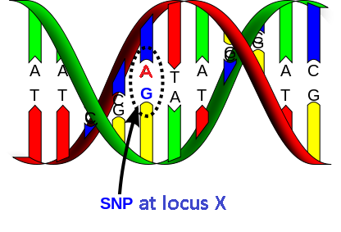
Important genetic terms
Given position in the genome (i.e. locus) has several associated alleles (A and G) which produce genotypes r_{A}/r_{G}
Haplotypes
  Combination of alleles at different loci

Slide 5
Genotype coding
For given bi-allelic marker/SNP/loci there could be total of 3 possible genotypes given alleles A and a
Note: A is major allele and a is minor
Genotype | Coding
AA | 0
Aa | 1
aa | 2

Slide 6
Stats Review: Multiplication Rule
Only valid for independent events (e.g. A and B)
P(A and B) = P(A) * P(B)
Table of probabilities of events A and B
P(A) = 0.20, P(B) = 0.70, A and B are independent
P(A and B) = 0.20 * 0.70 = 0.14
 | B | B' (not B) | Marginal
A | 0.14 | 0.06 | 0.2
A' (not A) | 0.56 | 0.24 | 0.8
Marginal | 0.7 | 0.3 | 1

Slide 7
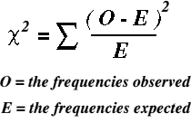
Stats review: Chi square test
Tests if there is a difference between two normal distributions (e.g. observed vs theoretical)
  Hypothesis based test
  Pearson's chi-squared test of independence (default)
  H_{o}: null hypothesis stating that markers have no association to the trait (e.g. disease state)
  H_{a}: alternative hypothesis there is non-random association

Slide 8
X² test - hypothetical example
Given data on individuals, determine if there is association between smoking and disease?
X² = 105[(36)(25) - (14)(30)]² / (50)(55)(39)(66)
X² = 3.4178 → p-value = 0.065 @ df=1
Conclusion: no statistical significant link at α=0.05 (p<0.05) between smoking and disease occurrence
 | Smoker | Non-smoker | Total
Cases | 36(a) | 14 (b) | 50 (a+b)
Controls | 30(c) | 25 (d) | 55 (c+d)
Total | 66 (a+c) | 39 (b+d) | 105 (N)

Slide 9
Genetic association studies types
Main association study designs
  Family based
    Composed of samples taken from given family.
    Samples are dependent (on family structure)
  population-based
    Composed of samples taken from general population.
    Samples are independent (ideally)
A fundamental assumptions of the case-control study[4]:
  selected individuals have unbiased allele frequency
    i.e. markers are in linkage equilibrium and segregate independently
  taken from true underlying distribution
  If assumptions violated
  association findings will merely reflect study design biases

Slide 10
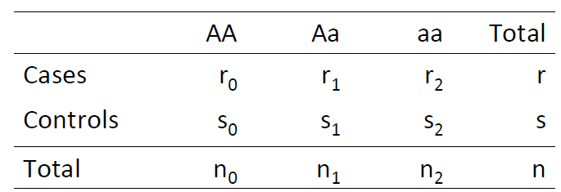
Genetic Models and Underlining Hypotheses
Can work with observations at:
  Genotypic level (A/A, A/a or a/a)
  To test for association with trait (cases/controls)
    X² independence test with 2 d.f. is commonly used

Slide 11

X² test of association for binary trait
At allelic level
  X² independence test with 1 d.f.
  $$X^{2}=2n\frac{{\left[\left(2r_{o}+r_{1}\right)\left(2s_{2}+s_{1}\right)−\left(2r_{2}+r_{1}\right)\left(2s_{o}+s_{1}\right)\right]}^{2}}{2r∗2s∗\left(2n_{o}+n_{1}\right)∗(2n_{2}+n_{1})}$$
 | A | a | Total
Cases | 2r_{o}+r₁ | 2r₂+r₁ | 2r
Controls | 2s_{o}+s₁ | 2s₂+s₁ | 2r
Total | 2n_{o}+n₁ | 2n₂+n₁ | 2n

Slide 12
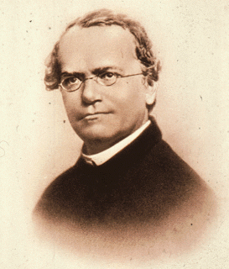
Trait inheritance
Allelic penetrance - the proportion of individuals in a population who carry a disease-causing allele and express the disease phenotype [5]
  Trait T: coded phenotype
  Penetrance: P(T|Genotype)
  Complete penetrance: P(T|G) = 1
Mendelian inheritance – traits that follow Mendelian Laws of inheritance from parents to children (e.g. eye/hair color)
  alleles of different genes separate independently of one another when sex cells/gametes are formed
  not all traits follow these laws (allele conversion, epigenetics)

Slide 13
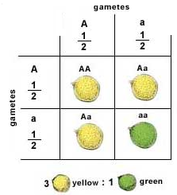
Genetic allelic dominance
Dominance describes relationship of two alleles (A and a) in relation to final phenotype
  if one allele (e.g. A) “masks” the effect of other (e.g. a) it is said to be dominant and masked allele recessive
  Here the dominant allele A gives pea a yellow color
Source: http://nissemann.blogspot.be/2009_04_01_archive.html
Homozygote dominant: AA
Heterozygote: Aa
Homozygote recessive: aa
Notes:
Homozygote:

Slide 14
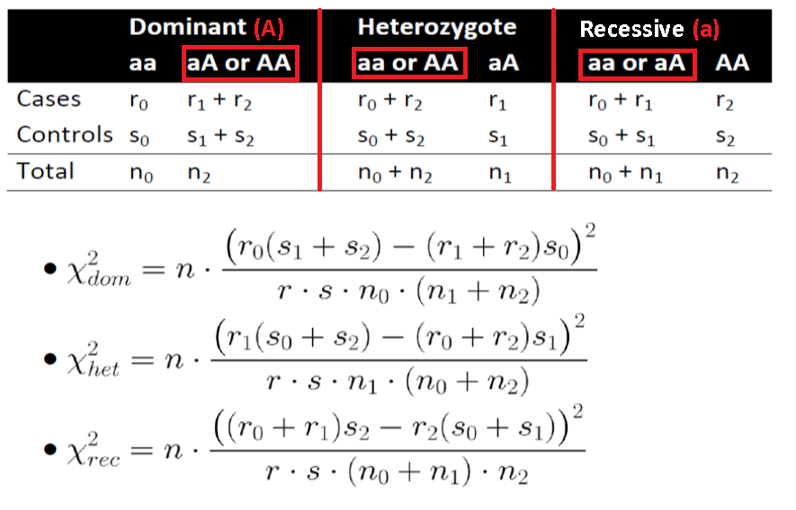
Genotype genetic based models
Hypothesis (H_{o}): the genetic effects of AA and Aa are the same (A is dominant allele)
Hypothesis (H_{o}): the genetic effects of aa and AA are the same
Hypothesis (H_{o}): the genetic effects of aa and Aa are the same (a is recessive allele)
Dominant
Heterozygous
Recessive

Slide 15
Genotype genetic based models
a multiplicative model (allelic based)
  the risk of disease is increased n-fold with each additional disease risk allele (e.g. allele A);
an additive model
  risk of disease is increased n-fold for genotype a/A and by 2n-fold for genotype A/A;
a recessive model
  two copies of allele A are required for n-fold increase in disease risk
dominant model
  either one or two copies of allele A are required for a n-fold increase in disease risk
multifactorial/polygenic for complex traits
  multifactorial (many factors) and polygenic (many genes)
  each of the factors/genes contribute a small amount to variability in observed phenotypes

Slide 16
Cochran-Armitage trend test
If there is no clear understanding of association between trait and genotypes – trend test is used
Cochran-Armitage trend test
  used to test for associations in a 2 × k contingency table with k > 2
  the underlying genetic model is unknown
  can test additive, dominant recessive associations

Slide 17
Which test should be used?
Depends to apriori knowledge and dataset
Trend test if no biological hypothesis exists
  Under additive model assumption trait test is identical allelic test if HWE criteria fulfilled
Dominant model for dominant-based traits
Recessive model for recessive -based traits
At low minor allele frequencies (MAFs), recessive tests have little power

Slide 18
Measurement of genetic effects on traits
The relative risk (RR):
  Compares the disease penetrances between individuals with different genotypes at assayed loci
  should not know outcome a priori (before the experiment ends)
  In typical case-control study where the ratio of cases to controls is controlled, it is not possible to make direct estimates of disease penetrance and RRs

Slide 19
Odds Ratio
The odds ratio of disease (OR):
  the probability that the disease is present compared with the probability that it is absent in cases vs controls
  the allelic OR describes the association between disease and allele
  the genotypic ORs describe the association between disease and genotype
Important: when disease penetrance is relatively small, there is little difference between RRs and ORs (i.e., RR ≈ OR)

Slide 20
OR illustration
Source: Iles MM. What can genome-wide association studies tell us about the genetics of common disease? PLoS Genet. 2008 Feb;4(2):e33
Histogram of estimated ORs (estimate of genetic effect size) at confirmed susceptibility loci

Slide 21
Regression methods under statistical genomics context

Slide 22

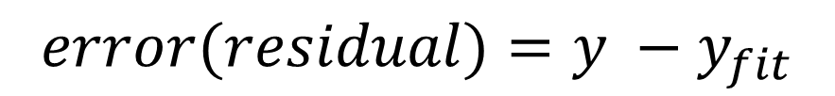

Regression analysis
A
Looks to explain relationship existing between single variable Y (the response, output or dependent variable) and one or more predictor, variables (input, independent or explanatory) X₁, …, X_{p} (if p>1 multivariate regression)
Advantages over correlation coefficient:
  Gives measure of how model fits data (y_{fit})
  Can predict other variable values (e.g. intercept)
$$y=a+bx$$
response co-variate x
$$error(residual)=y −y_{fit}$$

Slide 23
Regression analysis purposes
Regression analyses have several possible objectives including
  Prediction of future observations.
  Assessment of the effect of, or relationship between, explanatory variables on the response.
  A general description of data structure
The basic syntax for doing regression in R is lm(Y~model) to fit linear models and glm() to fit generalized linear models.
  Linear regression (continuous) and logistic regression (categorical) are special type of models you can fit using lm() and glm() respectively.

Slide 24
General syntax rules in R model fitting

Slide 25
Linear regression assumptions
There are four principal assumptions which justify the use of linear regression models for purposes of prediction:
  linearity of the relationship between dependent (y) and independent variables (x)
  independence of observations (not a time series)
  homoscedasticity (constant variance) of the errors
    versus time (residuals getting larger with time)
    versus the predictions
normality of the error distribution
  Detect skewness of errors (kurtosis test)
See http://www.duke.edu/~rnau/testing.htm

Slide 26
Linear regression – violation of linearity
Violations of linearity are extremely serious--if you fit a linear model to data which are nonlinearly related
  To detect
    plot of the observed versus predicted values or a plot of residuals versus predicted values, which are a part of standard regression output. The points should be symmetrically distributed around a diagonal line in the former plot or a horizontal line in the residuals plot. Look carefully for evidence of a "bowed" pattern
  To fix this issue
    nonlinear transformation to the dependent and/or independent variables
    adding another regressor which is a nonlinear function of one of the other variables (e.g. x²)

Slide 27
Coefficient of determination r²
The value r² is a fraction between 0.0 and 1.0, and has no units.
  value of 0.0 means no relationship (that is knowing X does not help you predict Y)
  value of 1.0, all points lie exactly on a straight line with no scatter. Knowing X lets you predict Y perfectly.

Slide 28
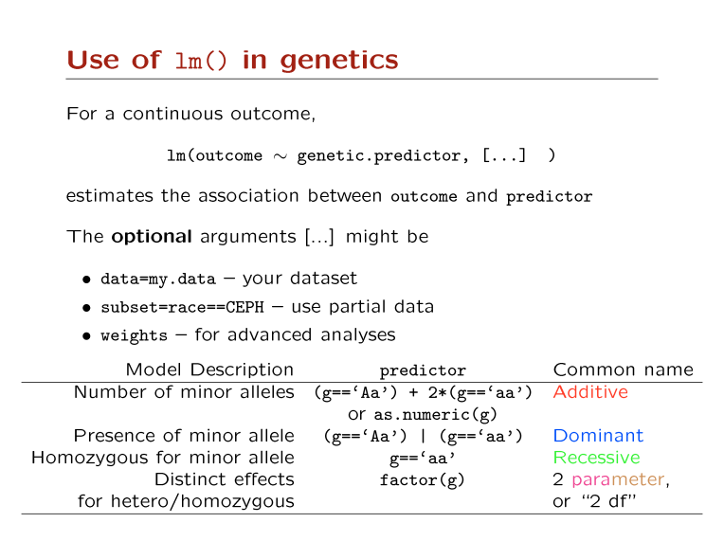

Slide 29
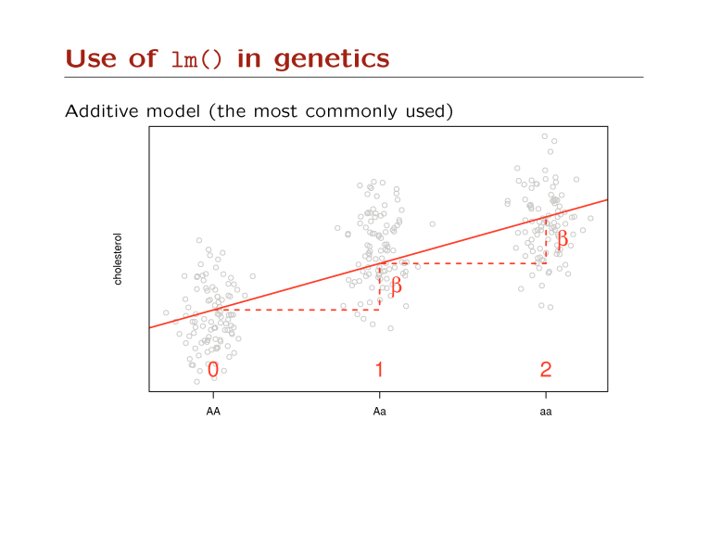

Slide 30
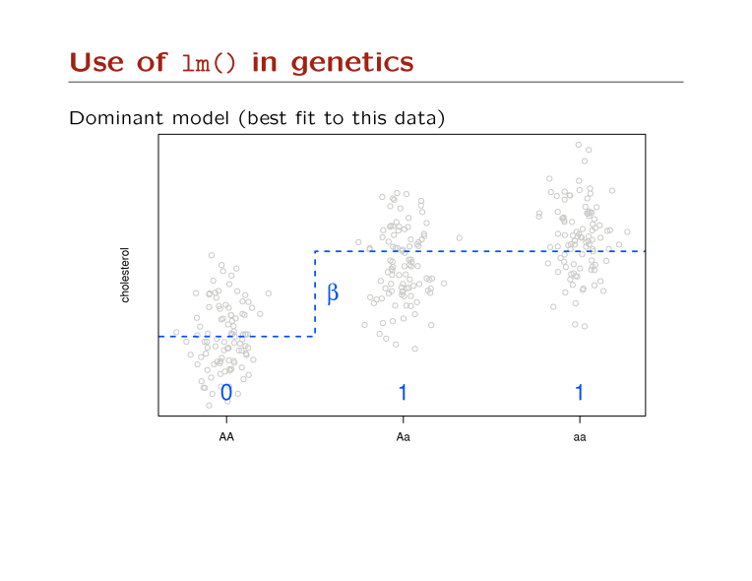

Slide 31
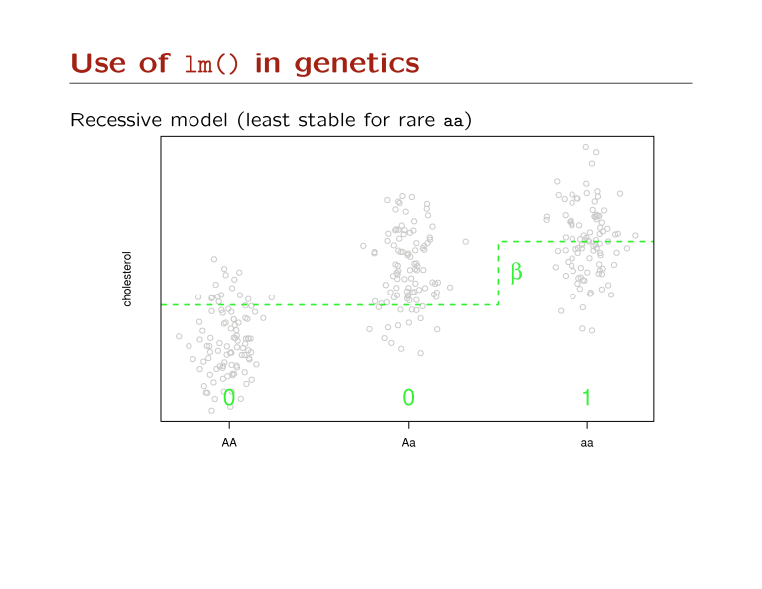

Slide 32
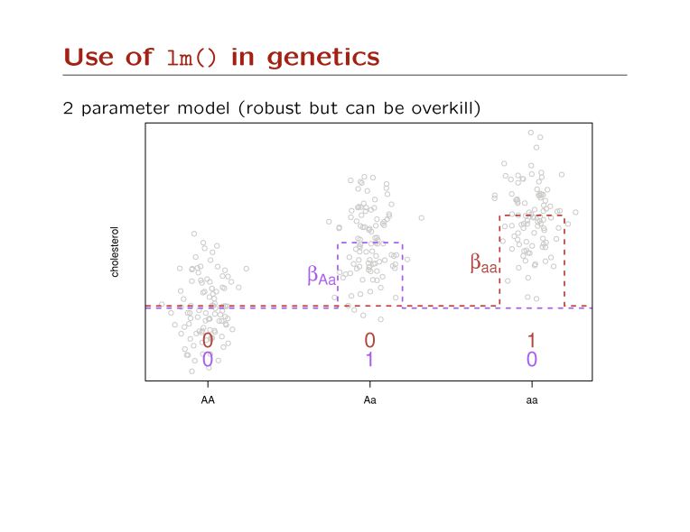

Slide 33
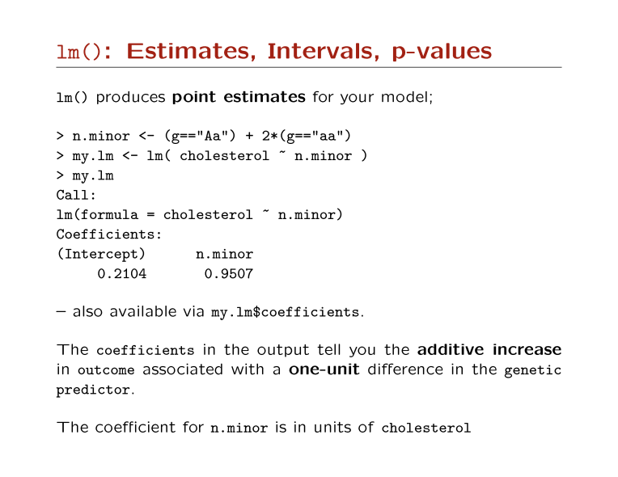

Slide 34
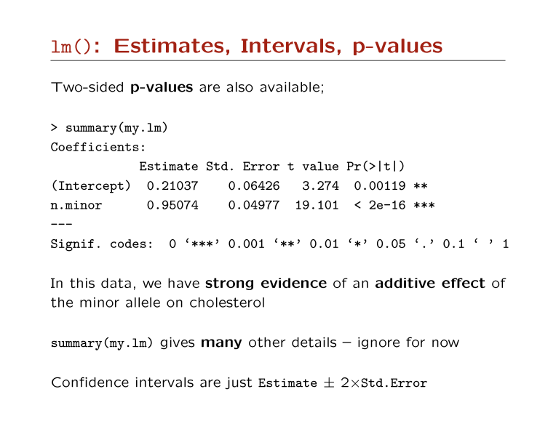

Slide 35
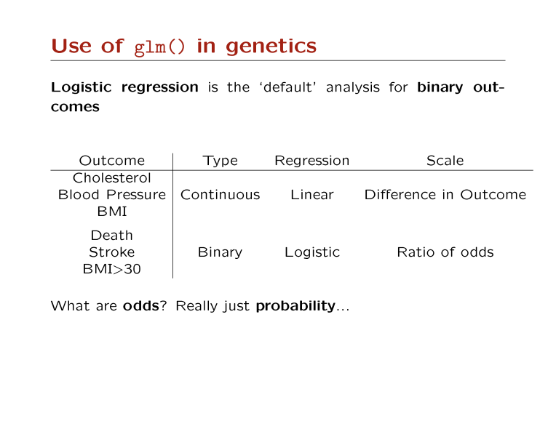

Slide 36
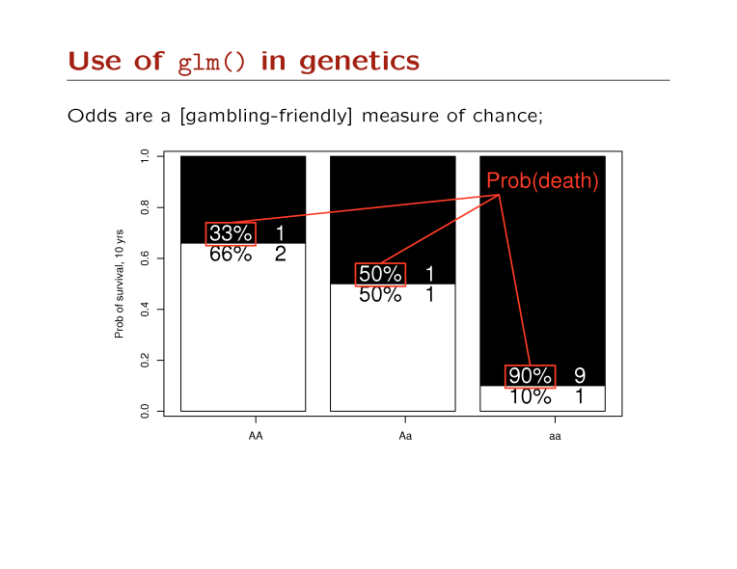

Slide 37

GenABEL library
A practical introduction to Genome Wide
Association Studies
1

Slide 38

GWAS main philosophy
• GWAS = Genome Wide Association Studies
• IDEA: GWAS involve scan for large number of
genetic markers (e.g. SNPs) (104→106) across
the whole genome of many individuals (>1000)
to find specific genetic variations associated with
the disease and/or other phenotypes
Find the genetic variation(s) that contribute(s) and explain(s) complex diseases
2

Slide 39
Why large number of subjects?
• The large number of study subjects are needed
in the GWAS because
- The large number of SNPs to small number of
individuals causes low odds ratio between SNPs and
casual variants (i.e. SNPs explaining given phenotype)
- Due to very large number of tests required with
associated intrinsic errors, associations must be
strong enough to survive multiple testing corrections
(i.e. need good statistical power)
3

Slide 40
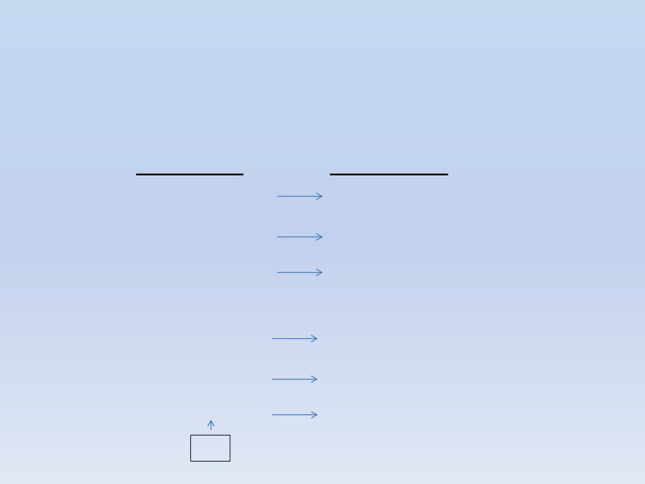
GWAS visually
• GWAS tries to uncover links between genetic basis of the disease
• Which set of SNPs explain the phenotype?
Genotype
Phenotype
ATGCAGTT
control
TTGCAGTT
control
CTGCAGTT
control
ATGCGGTT
case
TTGCGGTT
case
CTGCCGTT
case
SNP
4

Slide 41
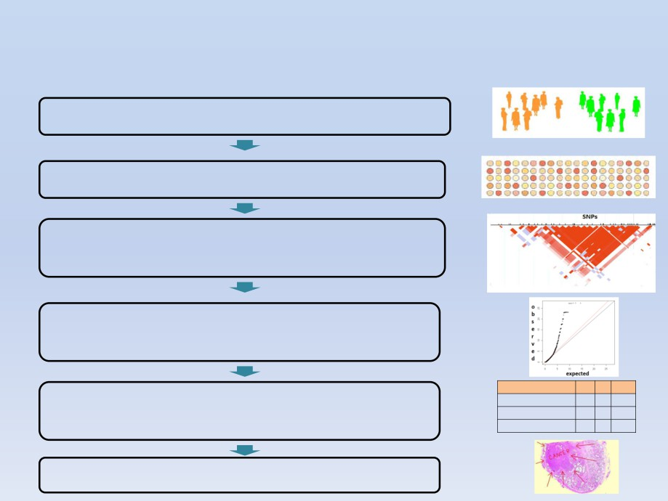
GWAS workflow
Large cohort (>1000) of cases and controls
Get genome information with SNP arrays
Find deviating from expected haplotypes
visualize SNP-SNP interactions using HapMap
Detection of potential association signals and their fine
mapping (e.g. detection of LD, stratification effect)
Replication of detected association in new cohot /
subset for validation purposes
AT AGTotal
cases observed 35 65 100
contorls observed12525100
Totals 160 90 200
Biological / clinical validation
5

Slide 42
Which tools to use to do
GWAS workflows?
How to find SNP-Disease
associations?
6

Slide 43
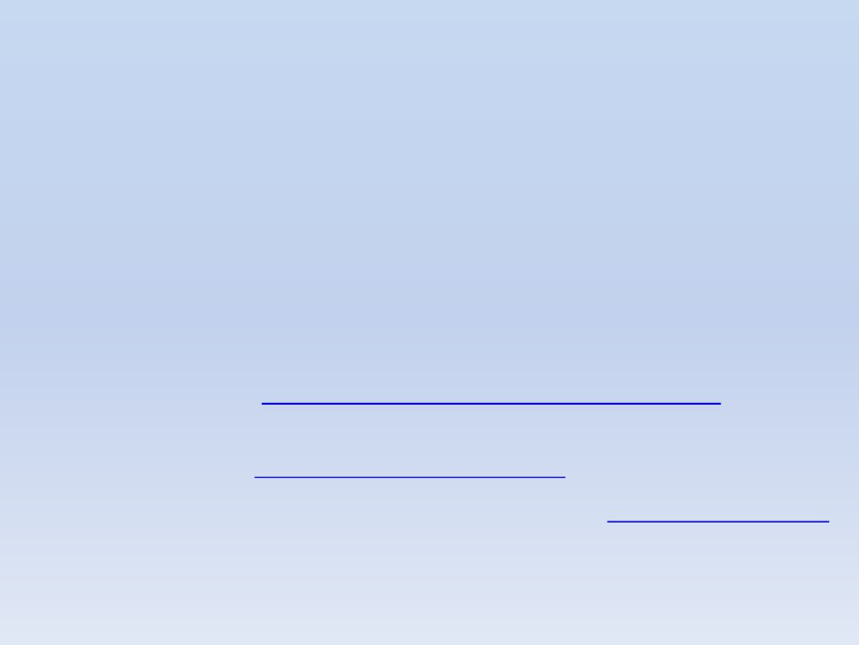
Common tools
• Some of the popular tools
- SVS Golden Helix (data filtering and normalization)
• Is commercial software providing ease of use compared to
other free solutions requiring use of numerous libraries
• Has unique feature on CNV Analysis
• Manual: http://doc.goldenhelix.com/SVS/latest/
- Biofilter (pre-selection of SNPs using database info)
(http://ritchielab.psu.edu/ritchielab/software/)
- GenABEL library implemented in R (http://www.genabel.org/)
7

Slide 44
Intro to GenABEL
• This library allows to do complete GWAS workflow
• GWAS data and corresponding attributes (SNPs,
phenotype, sex, etc.) are stored in data object
- gwaa.data-class
• The object attributes could be accessed with @
- phenotype data: gwaa_object@phdata
- number of people in study: gwaa_object@gtdata@nids
- number of SNPs: gwaa_object@gtdata@nsnps
- SNP names: gwaa_object@gtdata@snpnames
- Chromosome labels:gwaa_object@gtdata@chromosome
- # SNPs map positions: gwaa_object@gtdata@map
8

Slide 45
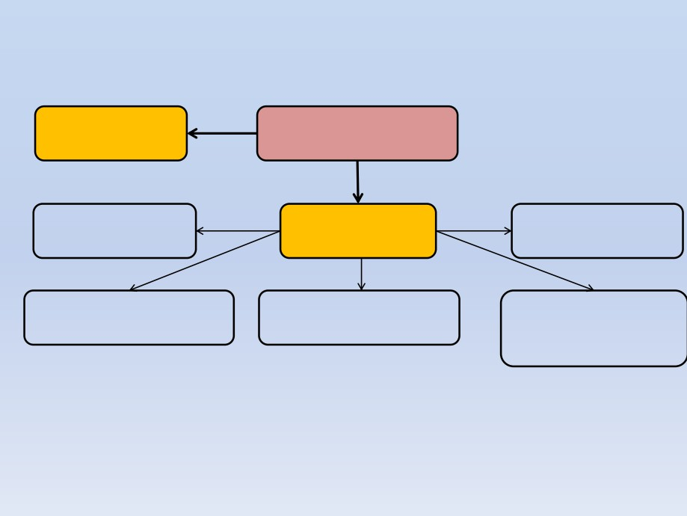
GeneABEL object structure
Phenotypic data
All GWA data stored in
object@phdata
gwaa.data-class object
# of people
Genetic data
location of SNPs
object@gtdata@nids
object@gtdata
object@gtdata@map
ID of study participants
Total # of SNPs
subject id and its sex
object@gtdata@idnames
object@gtdata@nsnps
object@gtdata@male
(1=male; 0= female)
9

Slide 46
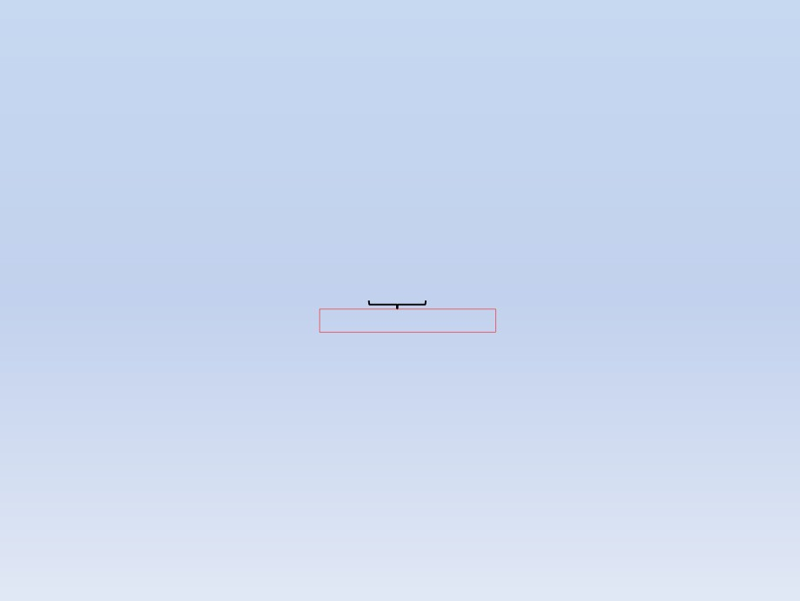
Hands on GenABEL
install.packages("GenABEL")
library("GenABEL")
data(ge03d2ex)
#loads data(i.e. from GWAS) on type 2 diabetes
summary(ge03d2ex)[1:5,]
#view first 5 SNP data
(genotypic data)
Chromosome Position Strand A1 A2 NoMeasured CallRate Q.2
P.11 P.12 P.22 Pexact Fmax Plrt
rs1646456 1 653 + C G 135 0.9926471 0.33333333
57 66 12 0.3323747 -0.10000000 0.2404314
rs4435802 1 5291 + C A 134 0.9852941 0.07462687
114 20 0 1.0000000 -0.08064516 0.2038385
rs946364 1 8533 - T C 134 0.9852941 0.27611940
68 58 8 0.3949055 -0.08275286 0.3302839
rs299251 1 10737 + A G 135 0.9926471 0.04444444
123 12 0 1.0000000 -0.04651163 0.4549295
rs2456488 1 11779 + G C 135 0.9926471 0.34814815
59 58 18 0.5698988 0.05343327 0.5360019
>= 0,98 means good genotyping
summary(ge03d2ex@phdata) #view phenotypic data
id sex age dm2 height
weight diet bmi
Length:136 Min. :0.0000 Min. :23.84 Min. :0.0000 Min. :150.2
Min. : 46.63 Min. :0.00000 Min. :17.30
Class :character 1st Qu.:0.0000 1st Qu.:38.33 1st Qu.:0.0000 1st Qu.:161.5
1st Qu.: 69.02 1st Qu.:0.00000 1st Qu.:24.56
Mode :character Median :1.0000 Median :48.71 Median :1.0000 Median :169.4
Median : 81.15 Median :0.00000 Median :28.35
Mean :0.5294 Mean :49.07 Mean :0.6324 Mean :169.4
Mean : 87.40 Mean :0.05882 Mean :30.30
3rd Qu.:1.0000 3rd Qu.:58.57 3rd Qu.:1.0000 3rd Qu.:175.9
3rd Qu.:102.79 3rd Qu.:0.00000 3rd Qu.:35.69
Max. :1.0000 Max. :81.57 Max. :1.0000 Max. :191.8
Max. :161.24 Max. :1.00000 Max. :59.83
NA's :1
NA's :1 NA's :1
A1 A2 = allele 1 and 2
Position = genomic position (bp)
Strand = DNA strand + or -
CallRate = allelic frequency expressed as a ratio
NoMeasured = # of times the genotype was observed
Pexact = P-value of the exact test for HWE
Fmax = estimate of deviation from HWE, allowing meta-analysis
10

Slide 47
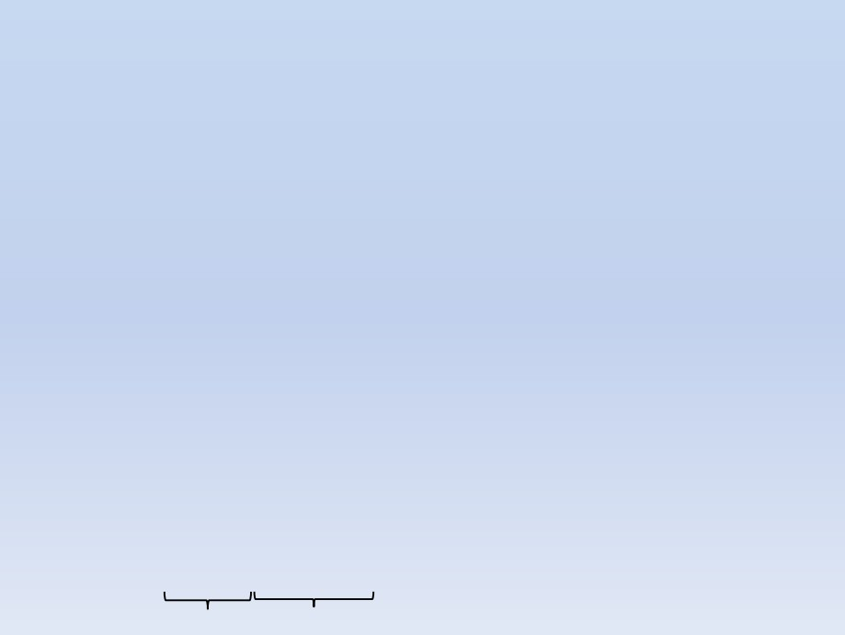
Exploring phenotypic data
• See aging phenotype data in compressed form
descriptives.trait(ge03d2ex)
id
No
Mean
SD
136
NA
NA
sex
136
0.529
0.501
age
136
49.069
12.926
dm2
136
0.632
0.484
height 135 169.440
9.814
weight 135
87.397
25.510
diet
136
0.059
0.236
bmi
135
30.301
8.082
• Extract all sexes of all individuals
ge03d2ex@phdata$sex # accessing sex column of the data frame with $
1 0 1 0 0 1 1 0 0 1 0 0 1 1 0 0 0 1 1 1 1 1 1 1 1 1 1 0 1 0 1 0 1 1 0 0 0 1 1 1 1 0 1 1
1 0 1 1 1 1 0 1 1 1 1 0 1 0 1 0 0 1 0 1 1 0 1 0 0 1 0 1 1 1 1 1 0 1 0 0 1 0 1 0 0 0 0 0
0 0 0 1 0 0 0 1 1 0 1 1 0 1 0 1 0 1 1 0 0 0 0 1 0 1 0 0 0 1 0 0 1 0 0 1 1 0 1 1 1 0 1 0
0 1 1 0
• Sorting data by binary attribute (e.g. sex)
descriptives.trait(ge03d2ex, by=ge03d2ex@phdata$sex)
No(by.var=0) Mean SD No(by.var=1)
Mean SD Ptt Pkw Pexact
id 64 NA NA
72 NA NA NA NA NA
sex 64 NA NA
72 NA NA NA NA NA
age 64 46.942 12.479
72 50.959 13.107 0.070 0.081 NA
dm2 64 0.547 0.502
72 0.708 0.458 0.053 0.052 0.074
height 64 162.680 6.819
71 175.534 7.943 0.000 0.000 NA
weight 64 78.605 26.908
71 95.322 21.441 0.000 0.000 NA
diet 64 0.109 0.315
72 0.014 0.118 0.025 0.019 0.026
bmi 64 29.604 9.506
71 30.930 6.547 0.352 0.040 NA
Females
Males
11

Slide 48
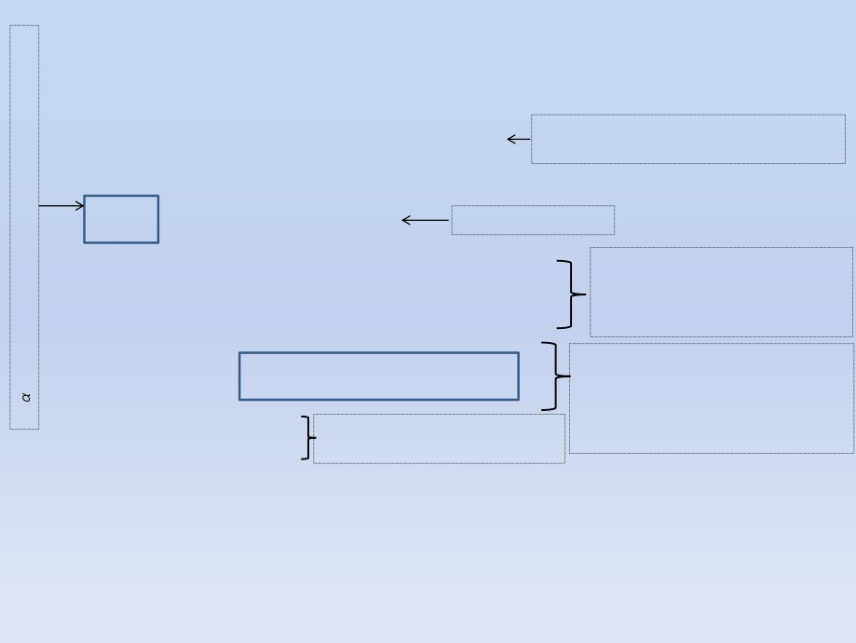
Exploring genotypic data / statistics
descriptives.marker(ge03d2ex)
$`Minor allele frequency distribution`
X<=0.01 0.01<X<=0.05 0.05<X<=0.1 0.1<X<=0.2 X>0.2
Number of copies minor/rare alleles out of
total number (i.e. 4000)
No 146.000 684.000 711.000 904.000 1555.000
Prop 0.036 0.171 0.178 0.226 0.389
α
$`Cumulative distr. of number of SNPs out of HWE, at different alpha`
X<=1e-04
X<=0.001 X<=0.01 X<=0.05 all X
No
46.000
71.000 125.000 275.000
4000
Total number of SNPs
Prop
0.012
0.018
0.031
0.069
1
$`Distribution of proportion of successful genotypes (per person)`
Proportion of missing values
X<=0.9 0.9<X<=0.95 0.95<X<=0.98 0.98<X<=0.99 X>0.99
No 1.000 0 0 135.000 0
(subject id9049 has missing info
on "sex" "age" "dm2" "height"
"weight" "diet" "bmi" )
Prop 0.007 0 0 0.993 0
$`Distribution of proportion of successful genotypes (per SNP)`
Number of SNPs that successfully were
X<=0.9 0.9<X<=0.95 0.95<X<=0.98 0.98<X<=0.99 X>0.99
No 37.000 6.000 996.000 1177.000 1784.000
able to identify sample genotype
(i.e. call rate). E.g. in this case
98% SNPs were able to identify /
Prop 0.009 0.002 0.249 0.294 0.446
$`Mean heterozygosity for a SNP`
[1] 0.2582298
Only 25% SNPs are heterozygous
(i.e. have different types of alleles)
explain more than 96% genotypes
$`Standard deviation of the mean heterozygosity for a SNP`
[1] 0.1592255
$`Mean heterozygosity for a person`
[1] 0.2476507
$`Standard deviation of mean heterozygosity for a person`
[1] 0.04291038
12

Slide 49
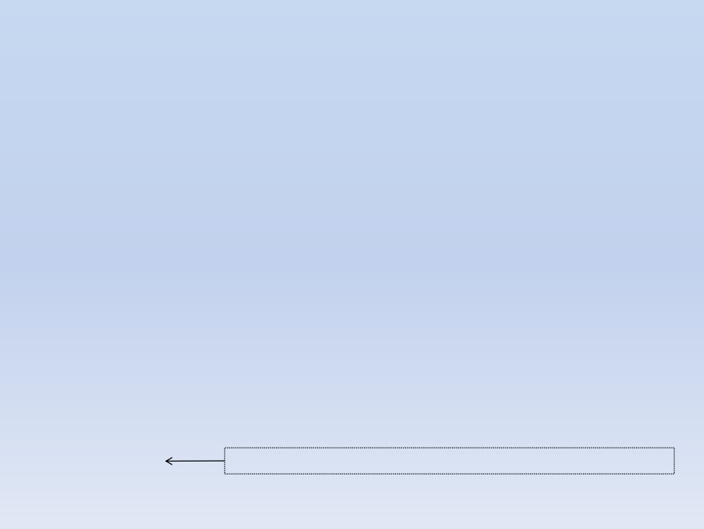
Assessing quality of the raw data (1)
1. Test for Hardy-Weinberg equilibrium given set of SNPs
- in controls (i.e. dm2 = 0)
dim(ge03d2ex@gtdata)
[1]
136 4000
ge03d2ex@phdata$dm2
1 1 1 1 1 1 1 1 1 1 1 1 1 1 1 1 1 1 1 1 1 1 1 1 1 1 1 1 1 1 1 1 1 1 1 1 1
1 1 1 1 1 1 1 1 1 1 1 1 1 1 1 1 1 1 1 1 1 1 1 1 1 1 1 1 1 1 1 1 1 1 1 1 1
1 1 1 1 1 1 1 1 1 1 1 0 0 0 0 0 0 0 0 0 0 0 0 0 0 0
0 0 0 0 0 0 0 0 0 0 0 0 0 0 0 0 0 0 0 0 0 0 0 0 0 0 0 0 0 0 0 0 0 0
summary(ge03d2ex@gtdata[(ge03d2ex@phdata$dm2 == 0),])
Chromosome Position Strand A1 A2 NoMeasured CallRate
rs1646456 1 653 + C G 50 1.00
Q.2 P.11 P.12 P.22 Pexact Fmax Plrt
rs4435802 1 5291 + C A 48 0.96
0.34000000 23 20 7 0.5275140 0.10873440 0.4448755
rs946364 1 8533 - T C 50 1.00
0.04166667 44 4 0 1.0000000 -0.04347826 0.6766092
rs299251 1 10737 + A G 50 1.00
0.33000000 22 23 5 1.0000000 -0.04025328 0.7750907
rs2456488 1 11779 + G C 50 1.00
0.06000000 44 6 0 1.0000000 -0.06382979 0.5358747
0.37000000 21 21 8 0.5450202 0.09909910 0.4849983
#extract the exact HWE test P-values into separate vector "Pexact"
Pexact0<-summary(ge03d2ex@gtdata[(ge03d2ex@phdata$dm2 == 0),])[,"Pexact"]
# perform chi square test on the Pexact values and calculate λ (inflation factor).
# If λ=1.0 no inflation or diflation of test statistic (i.e. no stratification effect)
estlambda(Pexact0, plot=TRUE)
$estimate
[1] 1.029817
$se
Inflation of test statistic (Pexact) is seen, see stratification effect
[1] 0.002185684
13

Slide 50
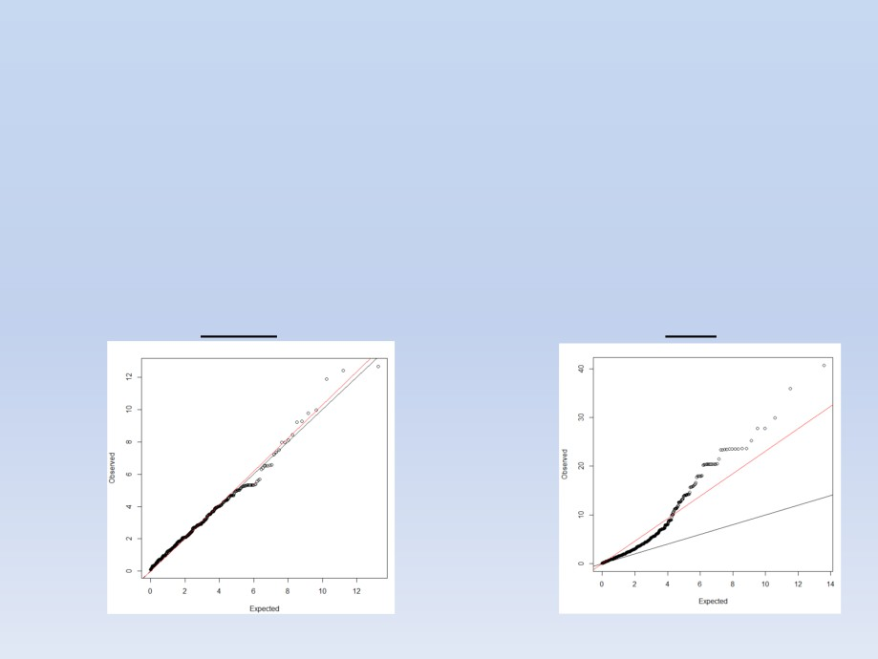
Assessing quality of the raw data (2)
1. Test for Hardy-Weinberg equilibrium on given set of SNPs
- in cases (i.e. dm2 = 1)
Pexact1<-summary(ge03d2ex@gtdata[(ge03d2ex@phdata$dm2 == 1),])[,"Pexact"]
estlambda(Pexact1, plot=TRUE)
$estimate
[1] 2.304846
$se
[1] 0.01319398
Controls (raw data)
Cases (raw data)
Q-Q plots:
14
The red line shows the fitted slope to the data. The black line represents the theoretical slope without any stratification

Slide 51
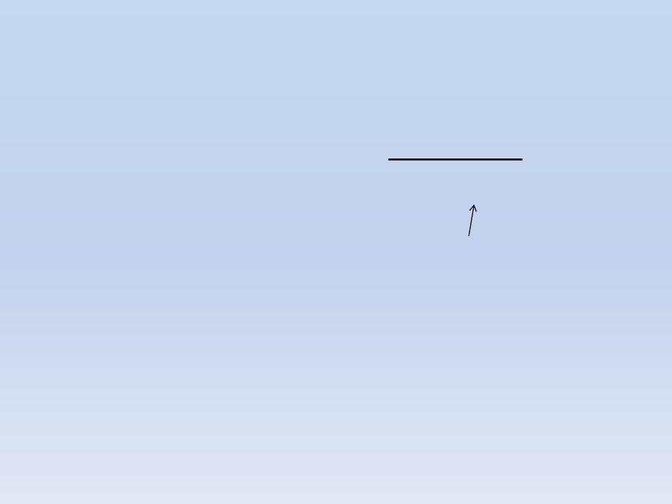
A Fast and Simple Method For Genomewide Pedigree-
Based Quantitative Trait - Loci Association Analysis
• Let’s apply a simple method that uses both mixed
model and regression to find statistically significant
associations between trait (presence/absence of
diabetes type 2) and loci (SNPs)
qTest = qtscore(dm2,ge03d2ex,trait="binomial")
descriptives.scan(qTest, sort="Pc1df")
Chromosome Position Strand A1 A2
N
effB
se_effB chi2.1df
P1df
effAB
effBB chi2.2df
P2df
Pc1df
rs1719133
1
4495479
+ T A 136 0.33729339 0.09282784 13.202591 0.0002795623 0.4004237
0.000000 14.729116 0.0006333052 0.0003504258
rs2975760
3 10518480
+ A T 134 3.80380024 1.05172986 13.080580 0.0002983731 3.4545455 10.000000 13.547345 0.0011434877 0.0003732694
rs7418878
1
2808520
+ A T 136 3.08123060 0.93431795 10.875745 0.0009743183 3.6051282
4.871795 12.181064 0.0022642036 0.0011762545
rs5308595
3 10543128
- C G 133 3.98254950 1.21582875 10.729452 0.0010544366 3.3171429
Inf 10.766439 0.0045930101 0.0012699705
rs4804634
1
2807417
+ C G 132 0.43411456 0.13400290 10.494949 0.0011970132 0.5240642
0.173913 11.200767 0.0036964462 0.0014362332
effAB / effBB = odds ratio of each possible genotype combination
P1df / P2df = probability values from GWA analysis
Pc1df = probability values corrected for inflation factor (stratification effects) at 1 degree of freedom
# plot the lambda corrected values and visualize the Manhattan plot
plot(qTest, df="Pc1df")
15

Slide 52
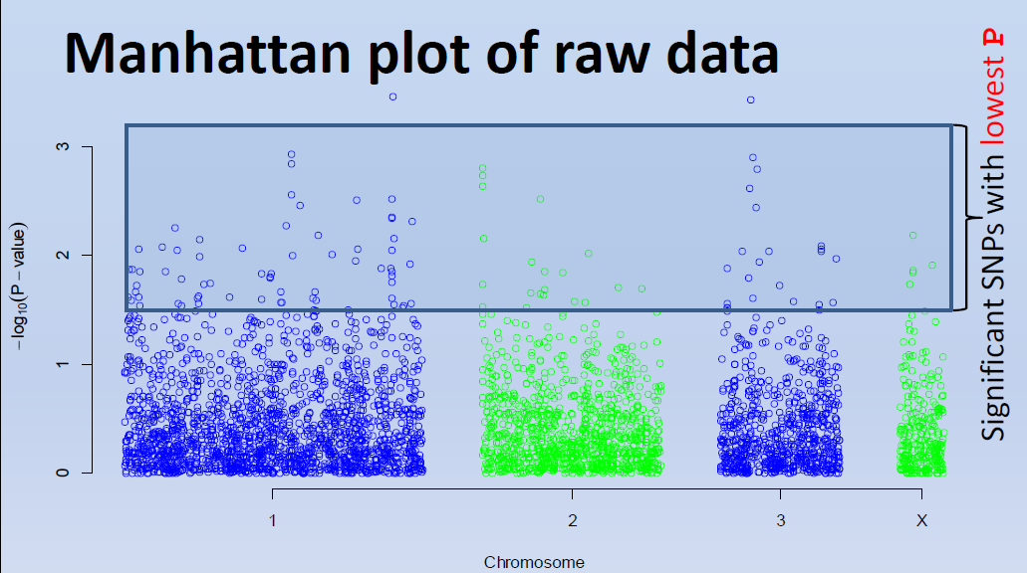
Manhattan plot of raw data
• To visualize to SNPs associated to the trait use
descriptives.scan(qTest)
• To see all the results covering all SNPs
results(qTest)

Slide 53
Empirical resembling with qtscore
• The previous GWA ran only once
• Lets re-run 500 times the same test with random
resembling of the data
- This method is more rigorous
- Empirical distribution of P-values are obtained
qTest.E <- qtscore(dm2,ge03d2ex,times=500)
descriptives.scan(qTest.E,sort="Pc1df")
Chromosome Position Strand A1 A2
N
effB
se_effB chi2.1df P1df Pc1df
effAB
effBB chi2.2df P2df
rs1719133
1
4495479
+ T A 136 -0.2652064 0.07298850 13.202591 0.458 0.540 -0.2080882 -0.7375000 14.729116 NA
rs2975760
3 10518480
+ A T 134
0.2340655 0.06471782 13.080580 0.478 0.558
0.2755102
0.4090909 13.547345 NA
rs7418878
1
2808520
+ A T 136
0.2089098 0.06334746 10.875745 0.862 0.912
0.2807405
0.3268398 12.181064 NA
rs5308595
3 10543128
- C G 133
0.2445516 0.07465893 10.729452 0.890 0.924
0.2564832
0.4623656 10.766439 NA
• None of the top SNPs hits the P<0.05 significance!
• None of the "P2df" values pass threshold (i.e. all = NA)
17

Slide 54
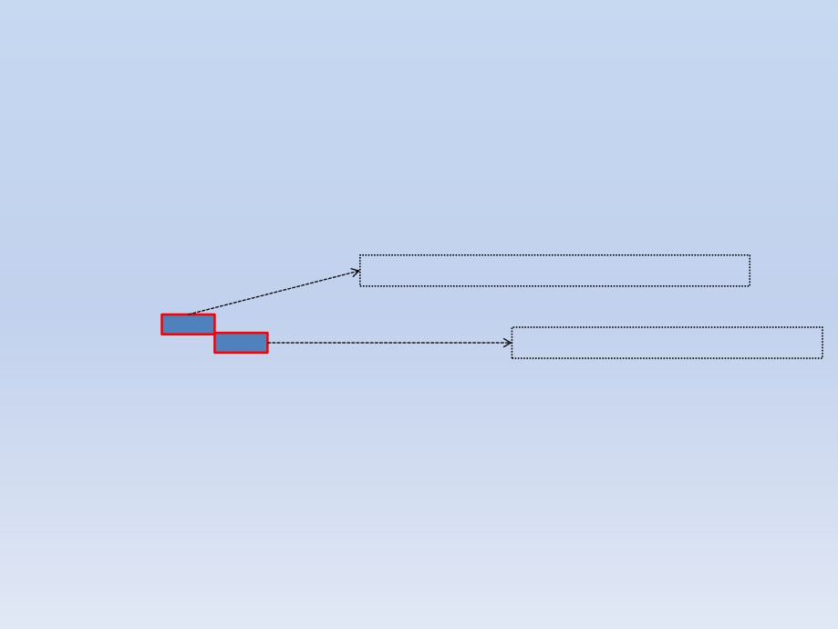
Quality Control (QC) of GWA data
• Since we suspect irregularities in our data we will do
- Simple QC assessment without HWE threshold
- Clean data
• Will run check.marker()QC function
QCresults <- check.marker(ge03d2ex,p.level=0)
summary(QCresults)
Number of SNPs with call rate lower than of 0.95
$`Per-SNP fails statistics`
NoCall NoMAF NoHWE Redundant Xsnpfail
NoCall 42 0 0 0 0
NoMAF NA 384 0 0 0
# of SNPs with MAF < 5/(2* # of SNPs)
NoHWE NA NA 0 0 0
Redundant NA NA NA 0 0
Xsnpfail NA NA NA NA 1
$`Per-person fails statistics`
IDnoCall HetFail IBSFail isfemale ismale isXXY otherSexErr
IDnoCall
1
0
0
0
0
0
0
HetFail
NA
3
0
0
0
0
0
IBSFail
NA
NA
2
0
0
0
0
isfemale
NA
NA
NA
2
0
0
0
ismale
NA
NA
NA
NA
0
0
0
isXXY
NA
NA
NA
NA
NA
0
0
otherSexErr
NA
NA
NA
NA
NA
NA
0
18

Slide 55
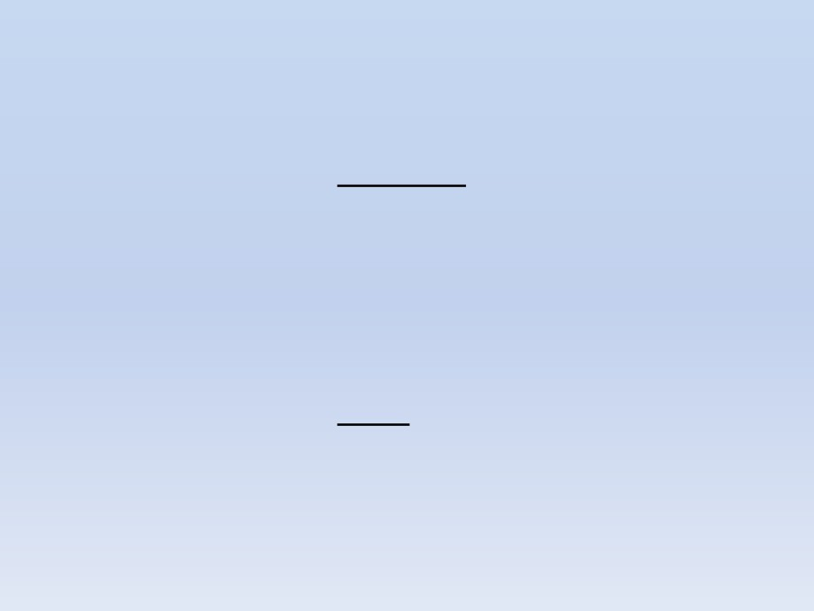
Checking QC results
• Check how many subjects PASSED the QC test
names(QCresults)
"nofreq"
"nocall"
"nohwe"
"Xmrkfail"
"hetfail"
"idnocall"
"ibsfail"
"isfemale"
"ismale"
"otherSexErr" "snpok" "idok"
"call"
QCresults$idok
"id199" "id300" "id403" "id415" "id666" "id689" "id765" "id830" "id908" "id980"
"id994" "id1193" "id1423" "id1505" "id1737" "id1827" "id1841" "id2068" "id2094" "id2097"
"id2151" "id2317" "id2618" "id2842" "id2894" "id2985" … "id6934“
length(QCresults$idok)
[1] 128
• Check how many SNPs PASSED the QC test
length(QCresults$snpok)
[1] 3573
#see the SNP ids that passed the QC test
QCresults$idok
19

Slide 56
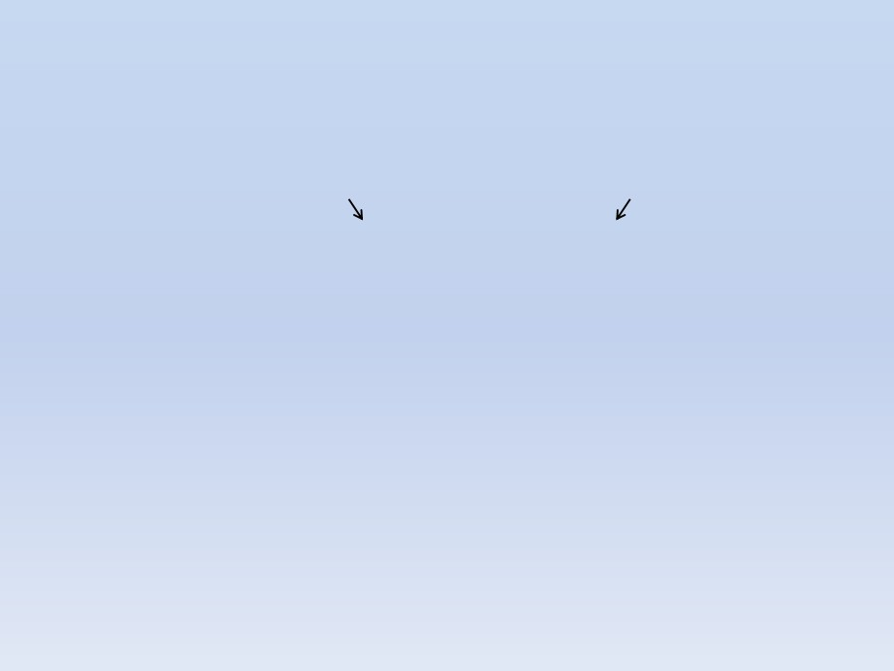
Select “cleaned” data
• Selection of data from original object BOTH:
- by particular individual
- by set of SNPs
ge03d2ex["id199", "rs1646456"]
id sex age dm2 height
weight diet bmi
id199 1 59.22872 1 163.9123
@nids = 1
80.40746 0 29.92768
@nsnps = 1
@nbytes = 1
@idnames = id199
@snpnames = rs1646456
@chromosome = 1
@coding = 11
@strand = 01
@map = 653
@male = 1
@gtps = 80
• Give vectors of QC passed SNPs and individuals
Cdata <- ge03d2ex[QCresults$idok, QCresults$snpok]
20

Slide 57
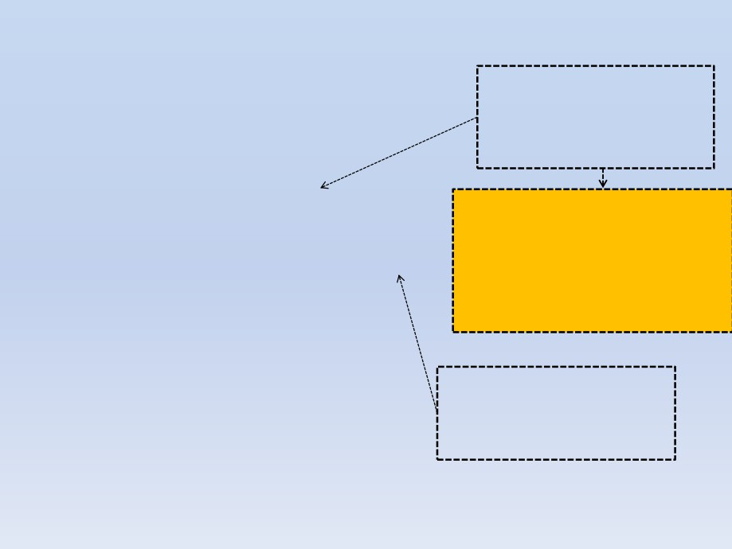
Check the quality of overall QC data
descriptives.marker(Cdata)
$`Minor allele frequency distribution`
Better but still lots of HWE
outliers. Population structure
X<=0.01 0.01<X<=0.05 0.05<X<=0.1 0.1<X<=0.2 X>0.2
No 0 508.000 677.000 873.000 1515.000
Prop 0 0.142 0.189 0.244 0.424
not accounted for?
$`Cumulative distr. of number of SNPs out of HWE, at different alpha`
X<=1e-04 X<=0.001 X<=0.01 X<=0.05 all X
No 44.000 66.000 117.000 239.000 3573
The lambda did not improved
significantly also indicating that the QC
Prop 0.012 0.018 0.033 0.067 1
$`Distribution of proportion of successful genotypes (per person)`
X<=0.9 0.9<X<=0.95 0.95<X<=0.98 0.98<X<=0.99 X>0.99
data still has factors not accounted for
No 0 0 0 65.000 63.000
estlambda(summary(Cdata)[,"Pexact"])
Prop 0 0 0 0.508 0.492
$estimate
[1] 2.150531
$`Distribution of proportion of successful genotypes (per SNP)`
X<=0.9 0.9<X<=0.95 0.95<X<=0.98 0.98<X<=0.99 X>0.99
No 0 0 458.000 814.000 2301.000
Prop 0 0 0.128 0.228 0.644
$`Mean heterozygosity for a SNP`
[1] 0.2787418
The genotype data has much
higher call rates since individuals
with NA values eliminated in the
range of > 99%
$`Standard deviation of the mean heterozygosity for a SNP`
[1] 0.1497257
$`Mean heterozygosity for a person`
[1] 0.26521
$`Standard deviation of mean heterozygosity for a person`
[1] 0.01888496
21

Slide 58
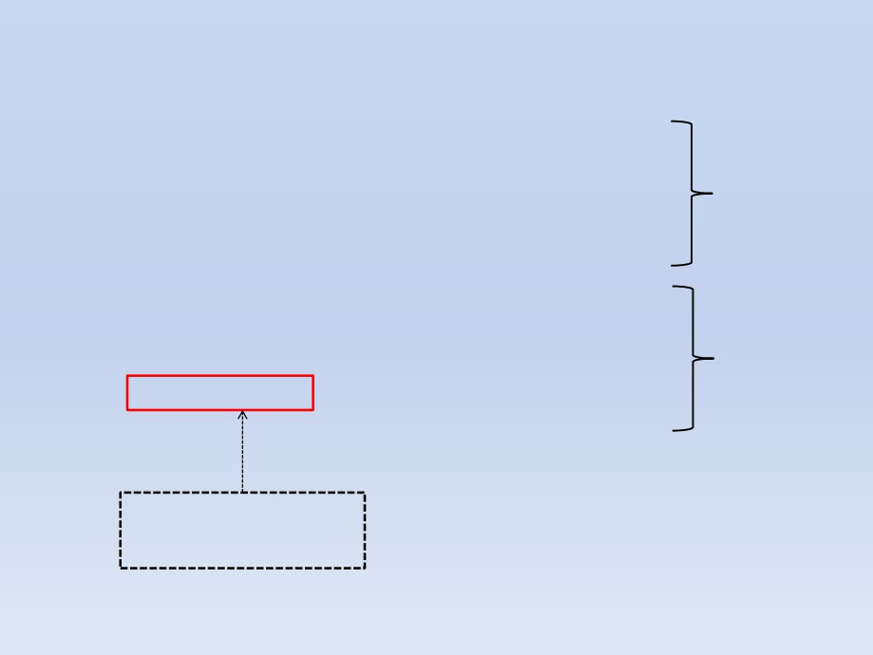
Which sub-group causing deviation from HWE?
descriptives.marker(Cdata[Cdata@phdata$dm2==0,])[2]
$`Cumulative distr. of number of SNPs out of HWE, at
different alpha`
X<=1e-04 X<=0.001 X<=0.01 X<=0.05 all X
controls
No 0 0 7.000 91.000 3573
Prop 0 0 0.002 0.025 1
descriptives.marker(Cdata[Cdata@phdata$dm2==1,])[2]
$`Cumulative distr. of number of SNPs out of HWE, at
different alpha`
X<=1e-04 X<=0.001 X<=0.01 X<=0.05 all X
No 46.000 70.00127.000228.000 3573
cases
Prop 0.013 0.02 0.036 0.064 1
As expected, the cases
display the greatest
deviation from HWE
22

Slide 59
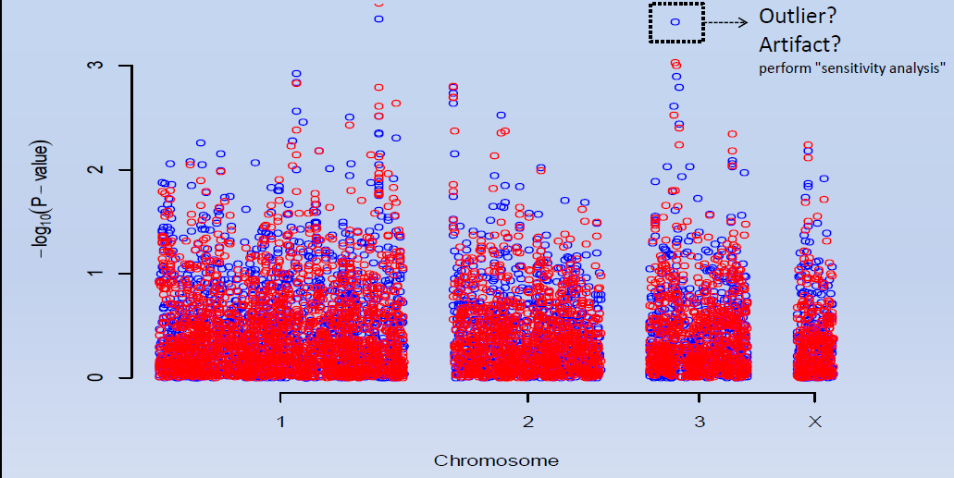
Compare raw and cleaned data
plot(qTest, df="Pc1df", col="blue")
qTest_QC = qtscore(dm2,Cdata,trait="binomial")
add.plot(qTest_QC , df="Pc1df", col="red")
Note that the cleaned data values are all lower this is due to lower λ value
23

Slide 60
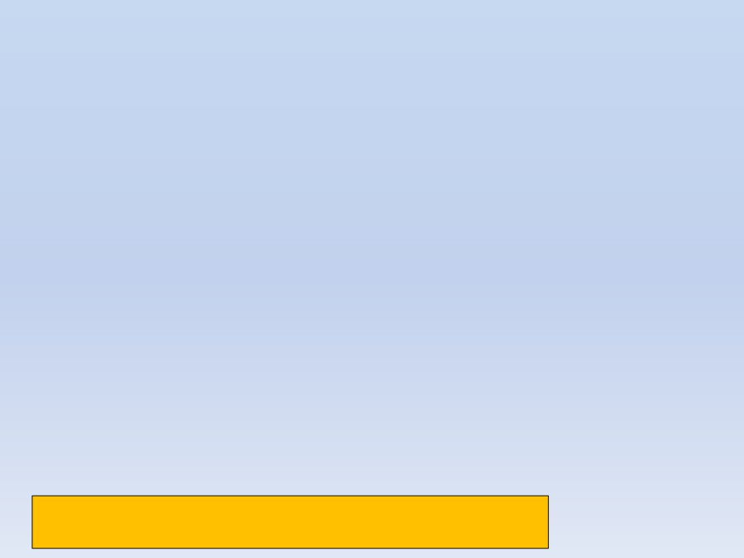
Finding population structure (1)
• The data seems to have clear population
substructure that we should account for in order to
do sensible data analysis
• Need to detect individuals that are “genetic outliers”
compared to the rest using SNP data
1. Will compute matrix of genetic kinship between
subjects of this study
Cdata.gkin <- ibs(Cdata[,autosomal(Cdata)],weight="freq")
Cdata.gkin[1:5,1:5]
id199
id300
id403
id415
id666
id199
0.494427766 3255.00000000 3253.00000000 3241.00000000 3257.0000000
id300 -0.011754266
0.49360296 3261.00000000 3250.00000000 3264.0000000
id403 -0.012253378
-0.01262949
0.50541775 3247.00000000 3262.0000000
id415 -0.001812109
0.01388179
-0.02515438
0.53008236
3251.0000000
id666 -0.018745051
-0.02127344
0.02083723
-0.02014175
0.5306584
The numbers below the diagonal show the genomic estimate of kinship ('genome-wide IBD'),
The numbers on the diagonal correspond to 0.5 plus the genomic homozigosity
The numbers above the diagonal tell how many SNPs were typed successfully for both subjects
24

Slide 61
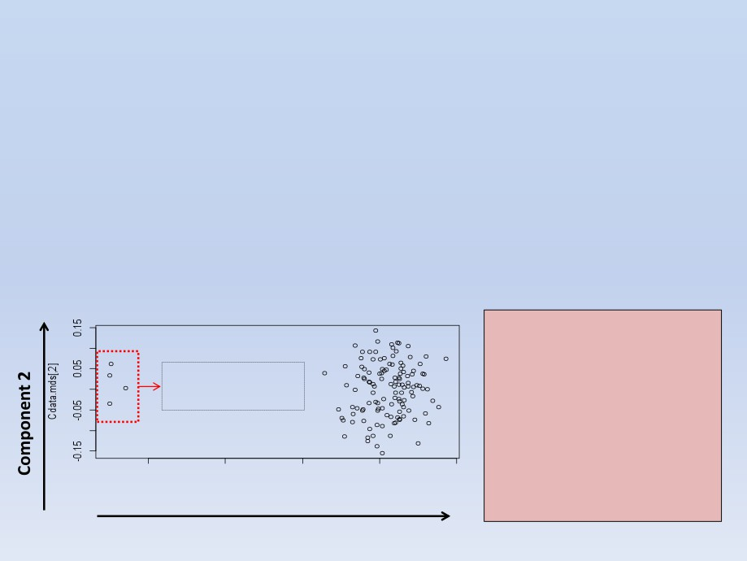
Finding population structure (2)
2. Compute distance matrix from previous
Cdata.dist <- as.dist(0.5-Cdata.gkin)
3. Do Classical Multidimensional Scaling (PCA)
and visualize results
Cdata.mds <- cmdscale(Cdata.dist)
plot(Cdata.mds)
• The PCA fitted the
genetic distances along
Outliers to exclude
(Individuals)
the 2 components
• Points are individuals
• There are clearly two
clusters
• Need to select all
individuals from biggest
cluster
Component 1
25

Slide 62
Second round of QC
• Select the ids of individuals from each cluster
- Can use k-means since clusters are well defined
kmeans.res <- kmeans(Cdata.mds,centers=2,nstart=1000)
cluster1 <- names(which(kmeans.res$cluster==1))
cluster2 <- names(which(kmeans.res$cluster==2))
• Select another clean dataset using data for
individuals in cluster #2 (the largest)
Cdata2 <- Cdata[cluster2,]
• Perform QC on new data
QCdata2 <- check.marker(Cdata2, hweids=(phdata(Cdata2)$dm == 0), fdr = 0.2)
26

Slide 63
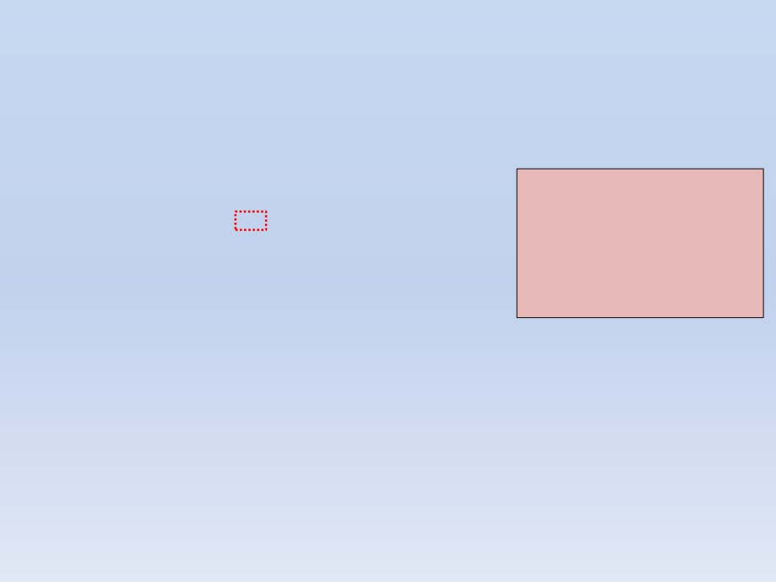
Second round QC results
• Visualize the QC results and make conclusions
summary(QCdata2)
$`Per-SNP fails statistics`
NoCall NoMAF NoHWE Redundant Xsnpfail
NoCall 0 0 0 0 0
• All markers passed the
HWE test
NoMAF NA 40 0 0 0
• 40 markers did not pass
NoHWE NA NA 0 0 0
the MAF QC test and
Redundant NA NA NA 0 0
Xsnpfail NA NA NA NA 0
need to be removed
• No phenotypic errors
$`Per-person fails statistics`
IDnoCall HetFail IBSFail isfemale ismale isXXY otherSexErr
IDnoCall
0
0
0
0
0
0
0
HetFail
NA
0
0
0
0
0
0
IBSFail
NA
NA
0
0
0
0
0
isfemale
NA
NA
NA
0
0
0
0
ismale
NA
NA
NA
NA
0
0
0
isXXY
NA
NA
NA
NA
NA
0
0
otherSexErr
NA
NA
NA
NA
NA
NA
0
• Clean the dataset again excluding those SNPs
Cdata2 <- Cdata2[QCdata2$idok, QCdata2$snpok]
27

Slide 64
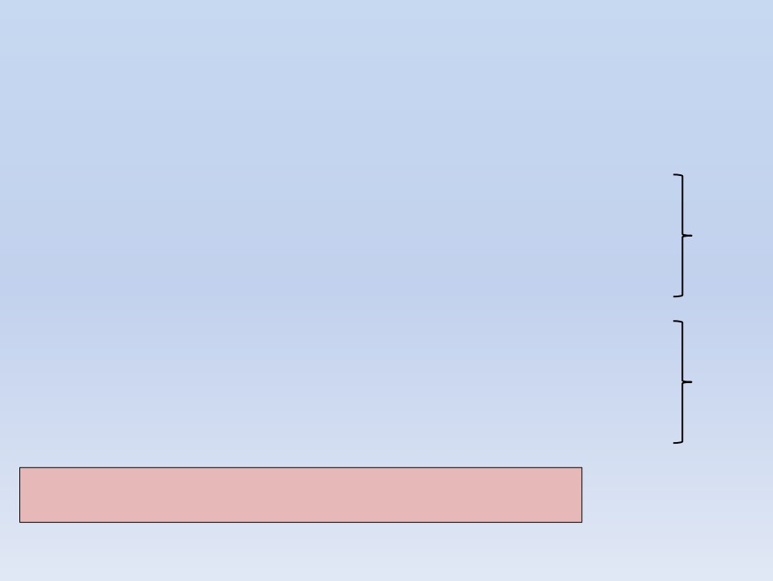
Final QC test before GWA (1)
• Final check on cases and controls QC data
descriptives.marker(Cdata2[phdata(Cdata2)$dm2==1,])[2]
$`Cumulative distr. of number of SNPs out of HWE, at different alpha`
X<=1e-04 X<=0.001 X<=0.01 X<=0.05 all X
No 0 1 17.000 79.000 3533
cases
Prop 0 0 0.005 0.022 1
descriptives.marker(Cdata2[phdata(Cdata2)$dm2==0,])[2]
$`Cumulative distr. of number of SNPs out of HWE, at different alpha`
X<=1e-04 X<=0.001 X<=0.01 X<=0.05 all X
No 0 0 7.000 91.000 3533
controls
Prop 0 0 0.002 0.026 1
• Finally most of markers are within the HWE at α < 0.05
• Still controls have marker distribution that better follows HWE
28

Slide 65
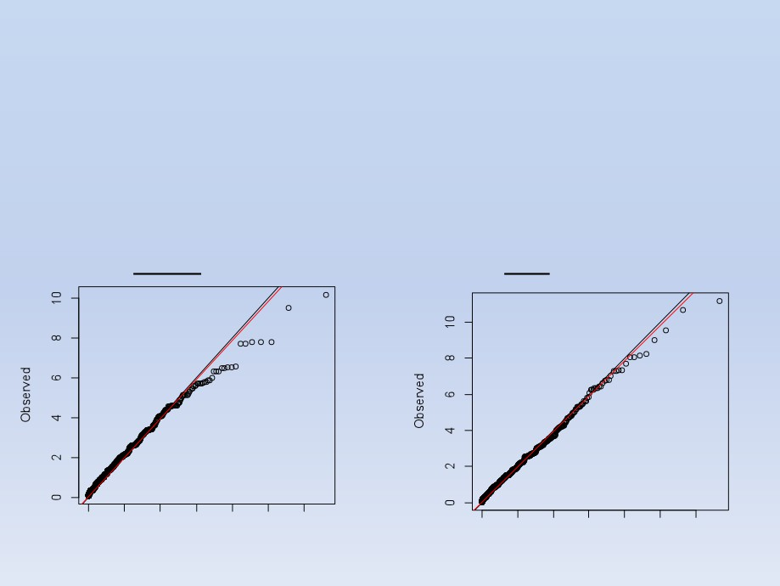
Final QC test before GWA (2)
• Do the X2 - X2 plot to have visual interpretation
estlambda(summary(Cdata2@gtdata[(Cdata2@phdata$dm2 == 0),])[,"Pexact"], plot=TRUE)
estlambda(summary(Cdata2@gtdata[(Cdata2@phdata$dm2 == 1),])[,"Pexact"], plot=TRUE)
Controls(cleaned data)
Cases (cleaned data)
0
2
4
6
8
10
12
Expected
29

Slide 66
Perform GWA on new data
• Perform the mixture model regression analysis
Cdata2.qt <- qtscore(Cdata2@phdata$dm2, Cdata2,trait="binomial")
descriptives.scan(Cdata2.qt,sort="Pc1df")
Summary for top 10 results, sorted by Pc1df
Chromosome Position Strand A1 A2
N
effB
se_effB chi2.1df
P1df
effAB
effBB chi2.2df
P2df
Pc1df
rs1719133
1
4495479
+ T A 124 0.3167801 0.08614528 13.522368 0.0002357368 0.3740771 0.0000000 14.677906 0.0006497303 0.0003048399
rs4804634
1
2807417
+ C G 121 0.4119844 0.12480696 10.896423 0.0009635013 0.6315789 0.1739130 12.375590 0.0020543516 0.0011885463
rs8835506
2
6010852
+ A T 121 3.5378209 1.08954331 10.543448 0.0011660066 4.0185185 4.0185185 12.605556 0.0018312105 0.0014292471
rs4534929
1
4474374
+ C G 123 0.4547151 0.14160410 10.311626 0.0013219476 0.4830918 0.1739130 10.510272 0.0052206352 0.0016136479
rs1013473
1
4487262
+ A T 124 2.7839368 0.86860745 10.272393 0.0013503553 3.0495868 5.8441558 10.926296 0.0042401869 0.0016471605
rs3925525
2
6008501
+ C G 124 3.2807631 1.03380675 10.070964 0.0015062424 3.6923077 4.0000000 11.765985 0.0027864347 0.0018306610
rs3224311
2
6009769
+ G C 124 3.2807631 1.03380675 10.070964 0.0015062424 3.6923077 4.0000000 11.765985 0.0027864347 0.0018306610
rs2975760
3 10518480
+ A T 123 3.1802120 1.00916993
9.930784 0.0016253728 3.0000000 8.0000000 10.172522 0.0061810866 0.0019704699
rs2521089
3 10487652
- T C 123 2.7298775 0.87761175
9.675679 0.0018672326 3.0147059 5.0000000 10.543296 0.0051351403 0.0022533033
rs1048031
1
4485591
+ G T 122 0.4510793 0.14548378
9.613391 0.0019316360 0.4844720 0.1714286
9.965696 0.0068545128 0.0023284084
• Compare results to the previous QC round 1 results
30

Slide 67
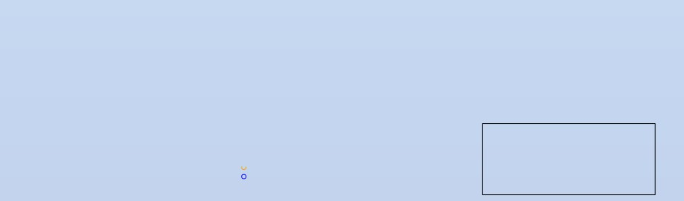
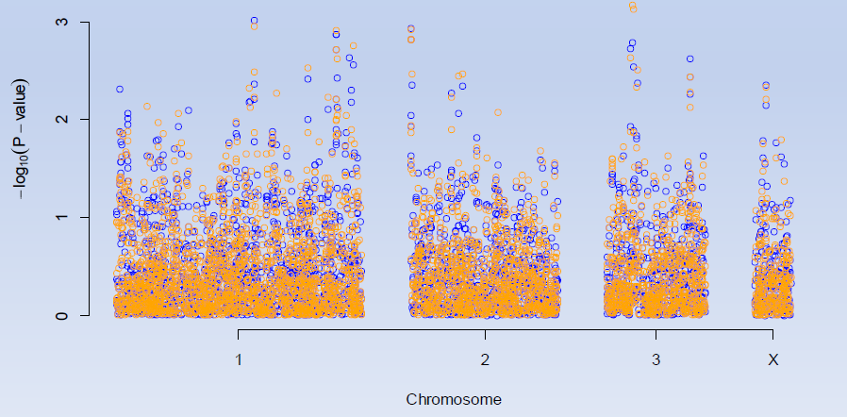
Manhattan plots
• Compare results QC round 1 vs QC round 2
plot(Cdata2.qt)
add.plot(qTest_QC, col="orange")
Round 1 QC
Round 2 QC
(accounted for population
stratification effects)
31

Slide 68
Perform more rigorous GWA test
computing GW (empirical) significance
• Will perform the GWA analysis 500 times obtaining GWA statistics
Cdata2.qte <- qtscore(Cdata2@phdata$dm2, times=500, Cdata2,trait="binomial")
descriptives.scan(Cdata2.qte,sort="Pc1df")
Summary for top 10 results, sorted by Pc1df
Chromosome Position Strand A1 A2
N
effB
se_effB chi2.1df P1df Pc1df
effAB
effBB chi2.2df P2df
rs1719133
1
4495479
+ T A 124 0.3167801 0.08614528 13.522368 0.346 0.402 0.3740771 0.0000000 14.677906 0.566
rs4804634
1
2807417
+ C G 121 0.4119844 0.12480696 10.896423 0.844 0.894 0.6315789 0.1739130 12.375590 0.944
rs8835506
2
6010852
+ A T 121 3.5378209 1.08954331 10.543448 0.886 0.938 4.0185185 4.0185185 12.605556 0.920
rs4534929
1
4474374
+ C G 123 0.4547151 0.14160410 10.311626 0.922 0.946 0.4830918 0.1739130 10.510272 1.000
rs1013473
1
4487262
+ A T 124 2.7839368 0.86860745 10.272393 0.924 0.952 3.0495868 5.8441558 10.926296 1.000
rs3925525
2
6008501
+ C G 124 3.2807631 1.03380675 10.070964 0.942 0.960 3.6923077 4.0000000 11.765985 0.986
rs3224311
2
6009769
+ G C 124 3.2807631 1.03380675 10.070964 0.942 0.960 3.6923077 4.0000000 11.765985 0.986
rs2975760
3 10518480
+ A T 123 3.1802120 1.00916993
9.930784 0.948 0.966 3.0000000 8.0000000 10.172522 1.000
rs2521089
3 10487652
- T C 123 2.7298775 0.87761175
9.675679 0.964 0.978 3.0147059 5.0000000 10.543296 1.000
rs1048031
1
4485591
+ G T 122 0.4510793 0.14548378
9.613391 0.966 0.982 0.4844720 0.1714286
9.965696
1.000
• Results had improved for the P2df statistic, but none of them
fall under GW significance level of 0.05
• rs1719133 does not pass the significance tests but is the
one with the best level of association compared to other SNPs
32

Slide 69
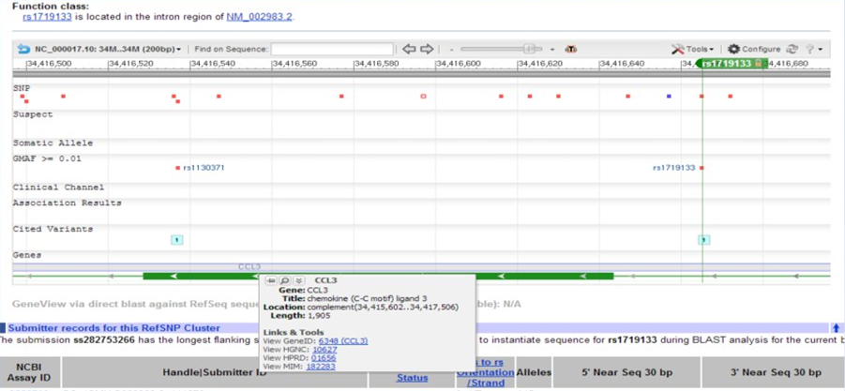
Biological interpretations
• For illustration purposes let’s extract information on the rs1719133
from dbSNP
• Seems to target CCL3 - pro-inflamatory cytokine. The CCL2 was
implicated in T1D [1]

Slide 70
Conclusions
GWA studies are popular these days mainly due to high throughput technology development such as genotyping chips (i.e. SNP arrays) and sequences
Analysis of GW data requires several steps of
quality control in order to draw conclusions
GenABEL provides tools to perform GWAs and automate some of the steps
34

Slide 71
References
[1] Ruili Guan et al. Chemokine (C-C Motif) Ligand 2 (CCL2) in Sera of Patients with Type 1
Diabetes and Diabetic Complications. PLoS ONE 6(4): e17822
[2] Yurii Aulchenko, GenABEL tutorial http://www.genabel.org/sites/default/files/pdfs/GenABEL-
tutorial.pdf
[3] GenABEL project developers, GenABEL: genome-wide SNP association analysis 2012, R
package version 1.7-2
[4] Geraldine M Clarke et.al. Basic statistical analysis in genetic case-control studies. Nat Protoc. 2011 February ; 6(2): 121–133
[5] Lobo, I. Same genetic mutation, different genetic disease phenotype. Nature Education 2008, 1(1)

